Slide 1
Datums, Spheroids and Projections.
What in the world are these all about?
Dr. Ronald Briggs
Professor Emeritus
The University of Texas at Dallas
Program in Geospatial Information Sciences
briggs@utdallas.edu

Slide 2
Geographic Information Systems and
Management Information Systems
What’s the difference?

Slide 3
The Uniqueness of GIS uses explicit location on earth’s surface to relate data
SS #
But I don’t have a SS # !!
We all have Latitude and Longtitude !!
Everything happens someplace. Is there anything more in common?
GIS “Allows the integration of disparate data hitherto confined to separate domains”
  --Maps and aerial photographs for example

Slide 5
A layer-cake of information
Disparate data is related based on common geographic coordinates
The GIS Data Model

Slide 6

In relational database terminology, location is the key field
Consequently, consistent and accurate determination of location is critical

Slide 7


Aligning data correctly
briggs@utdallas.edu
Determining Earth Location

Slide 8
Datums, Spheroids and Projections.
Why in h#$%^! won’t my data overlay?
Dr. Ronald Briggs
Professor Emeritus
The University of Texas at Dallas
Program in Geospatial Information Sciences
briggs@utdallas.edu

Slide 9
Determining Earth Location: Components
Geoid and Spheroids: modeling the earth
Latitude and Longitude: positioning on the model
Datums and Surveying: measuring the model
Map Projections: converting the model to 2 dimensions
Measurement (& other) error:
Location

Slide 10
The Shape of the Earth
3 concepts
Topographic or land surface
  the land/air interface
  complex (rivers, valleys, plains, plateaues, etc)
Geoid
  surface of equal gravity
  ---surface to which a plumb line is perpendicular (or a level is level)
  “that surface to which the oceans would conform over the entire earth if free to adjust to the combined effect of the earth's mass attraction and the centrifugal force of the earth's rotation.” Burkhard 1959/84
Spheres and spheroids (3-dimensional circles and ellipses)
  mathematical model used to represent the geoid
  provides the basis for accurate location (horizontal) and elevation (vertical) measurement

Slide 11
Land Surface, Geoid and Spheroid
GPS (global positioning system) measures elevation relative to spheroid.
Traditional surveying via leveling measures elevation relative to geoid.
Land surface
mean sea surface (geoid)
b -- semi-minor axis
Spheroid
<
>
a-- semi-major axis
a > b
ocean
Plumbline
perpendicular
to Geoid
--undulates due to gravity
Spheroid:
Mathematical model

Slide 12
Spheroid
Spheroid (or ellipsoid)
>
b -- semi-minor
axis
Our mathematical model of the geoid (or “the earth”)
All measurement (latitude and longitude) is relative to a spheroid
The question is…
which spheroid?
exact earth measurements
>
<
>
a-- semi-major axis
f = flattening = a-b
a
a = b = sphere (3D circle)
a > b = spheroid or ellipsoid (3D ellipse)
Approximate Earth measurements:
equatorial radius (a) : 6,378km 3,963mi
polar radius (b): 6,357km 3,950mi
(flattened about 13 miles at poles)

Slide 13
Which Spheroid?
Hundreds have been defined depending upon:
  available measurement technology
  area of the globe (e.g North America, Africa)
  map extent (country, continent or global)
  political issues (e.g Warsaw pact versus NATO)
ArcGIS supports over 25 different spheroids!
  conversions via math. formulae
Most commonly encountered are:
Everest (Sir George) 1830
  one of the earliest spheroids; India
  a=6,377,276m b=6,356,075m f=1/300.8
Clarke 1886 for North America
  basis for USGS 7.5 Quads
  a=6,378,206.4m b=6,356,583.8m f=1/295
GRS80 (Geodetic Ref. System, 1980)
  current North America mapping
  a=6,378,137m b=6,356,752.31414m f=1/298
Hayford or International (1909/1924)
  early global choice
  a=6,378,388 b=6,356,911.9m f=
WGS84 (World Geodetic Survey, 1984)
  current global choice
  functionally same as GRS80
  a=6,378,137 b=6,356,752.31m f=

Slide 14
Latitude and Longitude: location on the spheroid
Prime
Meridian
90° N
W 180°
180° E
  Measured in
  degrees°
  minutes”
  seconds’
  or
  decimal
  degrees
  dd= d°
  + m”/60
  + s’/3600
  0°
Equator
90° S
Longitude meridians
Prime meridian is zero: Greenwich, U.K.
International Date Line is 180° E&W
circumference: 40,008km = 24,860mi
(equator to pole approx. 10,000,000 meters, actually 10,001,965.7 meters )
1 degree=69.17 mi at Equator
48.99 mi at 45N/S
0 mi at 90N/S
Latitude parallels
equator is zero
circ.: 40,076km 24,902mi
1 degree=68.71 mi at equator (110,567m.)
69.40 mi at poles
(1 mile=1.60934km=5280 feet)
1 nautical mile=length of 1 minute
6080 ft = 1853.248m (Admiralty)
6076.115ft = 1852m (international)
(all distances based on WGS84 spheroid)

Slide 15
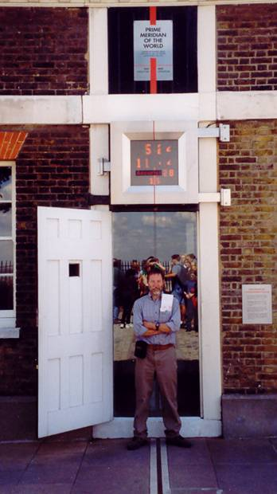
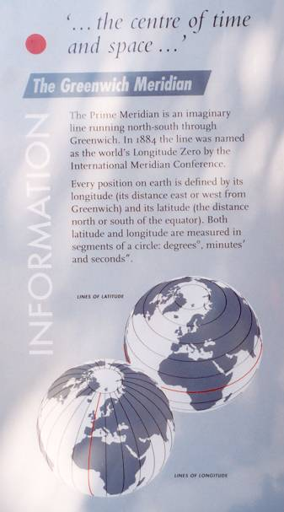
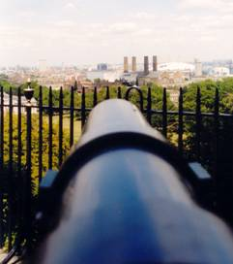
N
0°
S
E
W
Bisected by a hemisphere!

Slide 16
Geodesy & Surveying
Process of measuring position (horizontal control) and elevation (vertical control) of points on earth’s surface
Measuring the latitude and longitude (or other) coordinates of points
      Traditionally, used invar-tape, theodolites, and levels
      Now use lasers (for distance) and gps
    All measurements (horizontal and vertical)
    are relative to a datum

Slide 17
Datums:
--any numerical or geometrical quantity or set of such quantities which serve as a reference or base for other quantities
Horizontal datum
a set of parameters defining a coordinate system, including:
  the spheroid (earth model)
  a point of origin and an orientation relative to earth’s axis of rotation
    Called the tie point
All latitude and longitude measurements will be relative to a datum. You need to know it!
Vertical datum
a surface to which elevations are referenced
  Mean sea level (orthometric height)
  Spheroid (ellipsoid height)
Not necessarily the same. Again, you need to know it!
There is not necessarily a mathematical formulae for conversion between datums, although ‘equivalency tables’ may be available

Slide 18

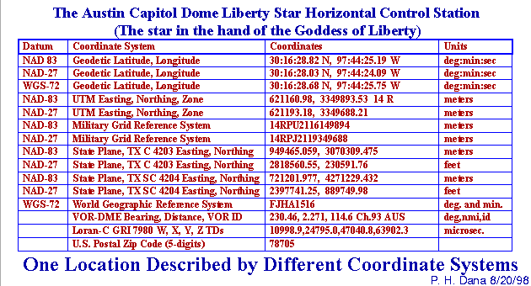
The significance of the datum
latitude/longitude coordinates for a location will change depending on the datum!
  Use a different spheroid
    Latitude/longitude coordinates change
  Use a different tie point to earth
    Latitude/longitude coordinates change
Source: Peter Dana: http://www.colorado.edu/geography/gcraft/notes/datum/datum_f.html
One location under different datums
You always need to know the datum!

Slide 19
Geodesy & Surveying and Datums: the differences
Geodetic Surveying (by geodesists):
  concerned with accurate measurement from global to local scale
  incorporates earth’s shape and curvature
  Create datums
  establish location of survey monuments based on datums
  conducted in US by the National Geodetic Service (previously the US Coast and Geodetic Survey) in the Dept. of Commerce
Plane Surveying (by surveyors):
  primarily operates at local scale (building site, sub-division, etc.)
  assume earth is flat
  Use datums
  use survey monuments established by geodesists as starting point.
  Conducted in US by State licensed surveyors (RPLS)

Slide 20
Original North American Datums
1900 US Standard Datum
  Clark 1866 spheroid
  origin Meades Ranch,
  Osborne Cnty, KS
  (39-13-26.686N 98-32-30.506W)
  created by visual triangulation
NAD27
  Clark 1866 spheroid
  Origin: Meades Ranch
  created by new visual triangulation
  NAVD29 (North American Vertical Datum, 1929) provides elevation
  basis for most USGS 7.5 minute quads
NAD83
  satellite (since 1957) and laser distance data showed inaccuracy of NAD27
  1971 National Academy of Sciences report recommended new datum
  GRS80 spheroid
  origin: Mass-center of Earth
  points can differ up to 160m from NAD27, but seldom more than 30m
  (note: data from a digitized paper map more inaccurate than datum difference)
  NAVD88 provides vertical datum
  completed in 1986 therefore called NAD83(1986)
  but new data coming from gps was more accurate!
  No single mathematical formulae converts NAD27 to NAD83:
  USGS Survey Bulletin # 1875 provides conversion tables
  or use NADCON software
  These are incorporated in ArcGIS.

Slide 21
Current US Datum Programs:
National Geodetic Reference System(NGRS)/ National Spatial Reference System(NSRS)
High Accuracy Reference Network (HARN)
Even before it was complete, gps showed NAD83 not sufficiently accurate
Fewer number of more easily accessible survey monuments established
Coordinates derived using gps
Revision known as NAD83(HARN)
  Issued on a regional basis from 1989 thru 1997
  Differs from NAD83 (1986) by <=1m (horizon.)
Continuously Operating Reference Stations (CORS)
continuous measurement of location from GPS satellites
posted hourly on the Internet
about 70 in TX as of 2007 run by TxDOT
datum revision know as NAD83 (CORSxx) since several been released (‘93, ‘94, ’96, etc)
  Diff. from NAD83 (HARN) <10cm
References:
Lapine, Lewis A. National Geodetic Survey: Its Mission, Vision, and Goals, US Dept of Commerce, NOAA, October, 1994
Snay and Soler Professional Surveyor Dec 1999, Feb 2000
http://geodesy.noaa.gov/CORS/standard1.shtml

Slide 22
Datums for Elevation: Geoid
Traditional surveying uses “leveling” to measure elevation relative to mean sea level (MSL)
  MSL is arithmetic mean of hourly water elevations observed over a 19 year cycle
  MSL is different for different countries or locations
US paper maps generally use NAVD29 or NAVD88
  NAVD88 based on mean sea level at Rimouski, Quebec, Canada on St Laurence gulf
Leveling based on mean sea level follows the geoid
  the elevation is measured relative to the geoid
  called orthometric height
  These are the elevations on most paper maps including USGS 7.5 minute Quads

Slide 23
Datums for Elevation: Ellipsoid
GPS (global positioning systems) know nothing about gravity or the geoid
  its elevations are relative to a spheroid
  called ellipsoid height
  This is usually WGS84 (for world) or GRS80 (for US): little practical difference
Orthometric height (geoid) and ellipsoid height (gps) are different
  by as much as 87 meters worldwide
  WGS84 spheroid is above geoid everywhere in US by an average of about 30m
  in Texas ellipsoid height is about 27 meters less (lower) than orthometric (geoid) ht.
Land surface
Geoid height
Ellipsoid height
Geoid
U.S.
Spheroid
Orthometric height

Slide 24
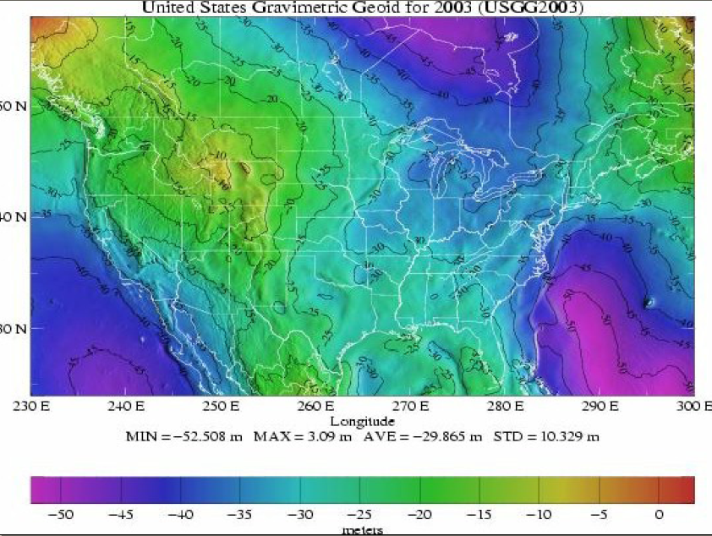
Converting Ellipsoid and Orthometric heights
Geoid12A is a gravity model of the geoid for the US and may be used to “correct” GPS elevations (ellipsoid height) to correspond to traditional surveyed heights above geoid (orthometric height) (or vis-a-versa)
Geoid heights for U.S.
(relative to WGS84 spheroid)
Values negative since geoid is below WGS84 spheroid
Texas average about -27m
The illustration and average values shown here are for Geoid03.
The current model (2014) is GEOID12Aww.ngs.noaa.gov/GEOID/GEOID12A
For tools, go to: https://www.ngs.noaa.gov/TOOLS/program_descriptions.html
For description, see Daniel Roman NGS Geodetic Toolkit, Part 6: Geoid Tools Professional Surveyor December 2003 Volume 23, Number 12, available at
https://www.ngs.noaa.gov/TOOLS/Professional_Surveyor_Articles/GEOID.pdf

Slide 25
Map Projections: the concept
A method by which the curved 3D surface of the earth is represented on a flat 2D map surface.
location on the 3D earth is measured by latitude and longitude
location on the 2D map is measured by x,y Cartesian coordinates

Slide 26
Map Projections: the inevitability of distortion
because we are trying to represent a 3-D sphere on a 2-D plane, distortion is inevitable
thus, every two dimensional map is distorted (inaccurate?) with respect to at least one of the following:
  area
  shape
  distance
  direction
We are trying to represent
this amount of the earth on
this amount of map space.

Slide 27
Map Projections:
Datum and projection not the same
The two are independent
  any projection can be used with any datum
Generally,
  Datum is a pre-established characteristic of the data
    You must know it, you shouldn’t change it
  Projection is a choice applied to the data
    By you, or the data supplier
    You must know if its been applied, but you can change it

Slide 28
Map projections: are mathematical equations which require input parameters and have output units
You need to know:
the mathematical equation (projection name)
the values of the parameters
  Usually include one or more locations, lines of longitude (meridians), or latitude (parallels) around which the projection is constructed
the point of origin and measurement units of X,Y output
  Usually meters, international feet or survey feet (differ by 2 ppm)
Knowing simply the projection name is not enough!
Must know all parameters and measurement units

Slide 29
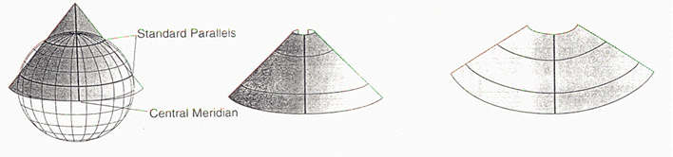
Projection Examples
(commonly encountered in GIS)
Albers Conic Equal-Area
  often used for US base maps showing all of the “lower 48” states
  area measurements are correct but shapes (and direction angles) are distorted
  parameters are standard parallels commonly set at 29 1/2N and 45 1/2N
Lambert Conformal Conic
  often used for US Base map of all 50 states (including Alaska and Hawaii)
  shape is correct (conformal) as is local direction
  parameters are standard parallels commonly set at 37N and 65N
Called “conic” because they can be envisaged by a cone

Slide 30
Parameters required to define
Lambert Conic Conformal
Latitude of first standard parallel (φ₁)
Latitude of second standard parallel (φ₂)
Latitude of false origin (φ_{F})
Longitude of false origin (λ_{F})
False easting (E_{F})
False northing (N_{F})
(units used to record false easting and false northing determine measurement unit)
Source: Geomatics Committee, International Association of Oil and Gas Producers, Geomatics Guidance Note Number 7, part 2 Coordinate Conversions and Transformations including Formulas, OGP Publication 373-7-2, June 2013 Available as g7-2.pdf at: www.epsg.org
(web site derives from former name European Petroleum Survey Group)

Slide 31
Map Projection Systems commonly encountered in GIS
sets of map projections with pre-defined parameters
a specific datum may also be assumed
UTM (Universal Transverse Mercator)
world divided into 60 N/S zones each 6° wide
transverse mercator projection defined for each
identified by Zone # 1-60.
implicitly assumes units are meters and datum is WGS84
SPCS (State Plane Coordinate System)
Each US state divided into 1-5 zones (~130 in all)
Projection and parameters defined for each
Identified either by DatumID or FIPSID
Some parameters differ for SPCS27 (GRS27 datum) and SPCS83 (GRS83 datum)

Slide 32
UTM Detail
first adopted by US Army in 1947 for large scale maps worldwide
used from lat. 84°N to 80°S; Universal Polar Stereographic (UPS) used for polar areas
globe divided into 60 N/S zones, each 6° wide; these are numbered from one to sixty going east from 180th meridian
  Conformal, and by using transverse form with zones, area distortion significantly reduced
each zone divided into 20 E/W bands (or “belts”), each 8° high lettered from the south pole using C thru X (O and I omitted) thus north Texas in “S” belt from 32° (thru Hillsboro) to 40° (Nebraska/Kansas line).
  These belts of no real relevance for UTM, but important for MGRS and USNG (next slide)
the meridian halfway between the two boundary meridians for each zone is designated as the central meridian and a secant cylindrical projection is done for each zone
  Central meridian for zone 1 is at 177° W
  Standard meridians (secant projection) are approx.150 km either side of this; scale correct here
scale of central meridian reduced by .9996 to minimize scale variation in zone resulting in accuracy variation of approx. 1meter per 2,500 meters
coordinate origins are set:
  For Y: at equator for northern hemisphere; at 10,000,000m S. of equator for southern hemi.
  For X: at 500,000m west of central meridian
  thus no negative values within zone, and central meridian is at 500,000m East
102W
96W
40N KS/NE line
UTM in Texas:
3 zones
Dallas is in 14S
13
14
15
Band “S”
Midland
Lake
Tawakoni
32N Hillsboro
Definitive documentation: http://earth-info.nga.mil/GandG/publications/tm8358.2/TM8358_2.pdf
http://earth-info.nga.mil/GandG/coordsys/grids/universal_grid_system.html

Slide 33
UTM zonal concept

Slide 34
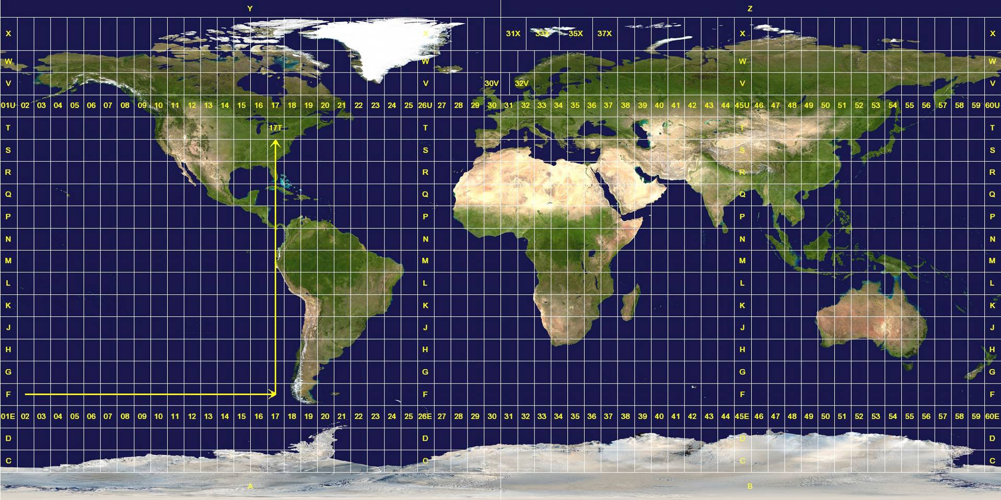
UTM (and USNG) Zones Worldwide
Equator
Prime Meridian
USNG: United States National Grid)
Source: Wikipedia

Slide 35
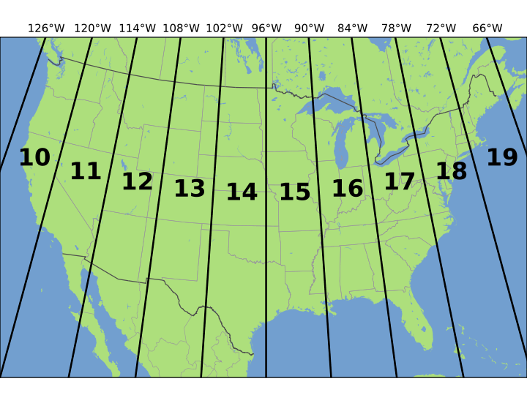
UTM (and USNG) Zones in US
48°N
T
40°N
S
32°N
R
Horizontal belts, 8° tall, lettered.
Used in military and USNG

Slide 36
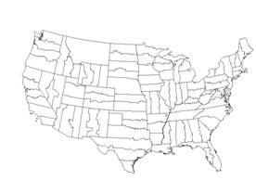
SPCS Detail
began in 1930s for public works projects; popular with interstate designers.
states divided into 1 or more zones (~130 total for US)
  each zone designed to maintain scale distortion to less than 1 part per 10,000
Texas has 5 zones running E/W: north (5326/4201), north central (5351/4202), Central (5376/4203), south central (5401/4204), south (5426/4205) (datumID/fipsID)
Different projections used:
  transverse mercator (conformal) for States with
  large N/S extent
  Lambert conformal conic for rest (incl. Texas)
  some states use both projections (NY, FL, AK)
  oblique mercator used for Alaska panhandle
each zone also has:
  unique standard parallels (2 for Lambert) or central meridian (1 for mercator)
  false coordinate origins which differ between zones, and use feet for NAD27
  and meters for NAD83
  (1m=39.37 inches exact used for conversion; differs slightly from NBS 1”=2.54cm)
  scale reduction used to balance scale across entire zone resulting in accuracy
  variation of approx. 1 per 10,000 thus 4 times more accurate than UTM
For details, see:
Snyder, 1982 USGS Bulletin # 1532, p. 56-63 http://pubs.usgs.gov/bul/1532/report.pdf
Stern, State Plane Coordinate System of 1983, NOAA Manual NOS NGS 5, March 1990 http://www.ngs.noaa.gov/PUBS_LIB/ManualNOSNGS5.pdf

Slide 37

The US displayed using a “Geographic Projection”
The term geographic projection is often used to refer to data in lat/long units.
Map of State Plane zones
treats lat/long as X,Y
has no desirable properties other than convenience
don’t do it!
Do not do it!

Slide 38
Handling Coordinates and Projections in ArcGIS
First, define datum and projection (if projected) for every data sets using ArcCatalog
Then, the the first layer opened in ArcMAP determines the coordinate reference system of the map display (view)
    Geographic (lat/long)
    Projected (by type and parameters)
As other layers are added, they are re-projected “on-the-fly” to that of the view
You can use Data Frame Properties to change the projection of the view
If datum and projection not defined first:
Coordinate reference system of the view is “not defined”
Subsequent layers, if not in the same system as the first layer, are potentially incorrectly superimposed

Slide 39
Measurement (and other) Errors
Measurement precision issues
  Lat and long measured in degrees° minutes” seconds’
    1 second = 100ft or 30m. approx. (at equator) (1m =3.2808ft)
    May need to carry decimal points on the seconds
  Decimal degrees, not minutes/seconds, best for GIS.
    dd= d° + m”/60 + s’/3600
    Must carry enough decimal points
    6 decimals give 10cm (4 inch) precision
Computer precision issues
  must use double precision storage for decimal degrees
    single precision accurate to only 2m
  You OK, but for old data was single precision used in the past?
GPS errors
  Selective Availability (SA) prior to May 2000: 100m accuracy
  GPS prior to WAAS (Wide Area Augmentation System): 10 m
    And its only in US
Base maps derive from scanned paper maps
  Modern GPS coordinates likely to be far more accurate

Slide 40
Stupid mistakes:
like failing to enter the correct sign
Prime
Meridian
N W
+ -
N E
+ +
S W
- -
S E
- +
When entering data, be sure to include negative signs.

Slide 41
If we pay attention to
Geoid and Spheroids: modeling the earth
Latitude and Longitude: positioning on the model
Datums and Surveying: measuring the model
Map Projections: converting the model to 2 dimensions
Measurement (& other) error:
Our data will overlay

Slide 43
Thank you for your attention! briggs@utdallas.edu

