Slide 1
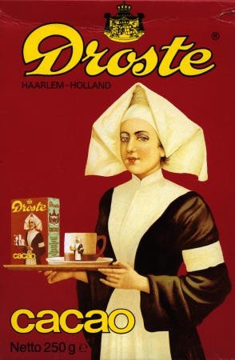
Good morning!

Slide 2
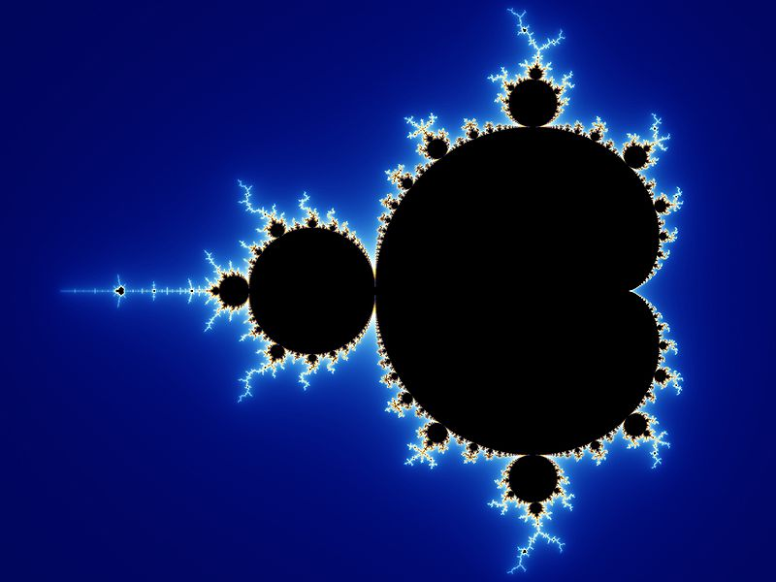

Slide 3
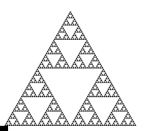

Slide 4
Recursive Algorithms
Dr. Jeyakesavan Veerasamy
jeyv@utdallas.edu

Slide 5
Example: Gift box!

Slide 6
Example: Gift box!

Slide 7
Example: Gift box!

Slide 8
Value of gift box : Equation?

Slide 9
Example: Treasure hunt!

Slide 10
What is recursion?
Popular in math definitions
Inductive proof

Slide 11
Example: factorial(n)

Slide 12
Example: factorial(n)
Non-recursive solution

Slide 13
How does recursion work?
Stack memory
How much stack memory is needed?

Slide 14
How to understand recursion?
Method invocations & returns diagram
Example: factorial(5)

Slide 15
How to understand recursion?
Method invocations & returns diagram
Example: fibonacci(n)

Slide 16
How to understand recursion?
Tree diagram
Example: fibonacci(n)

Slide 17
fibonacci(n) : non-recursive solution?

Slide 18
How to analyze recursion?
Recurrence relation & Time complexity

Slide 19
Example: Hanoi tower

Slide 20
Example: Fractals

Slide 21
Petrol cost minimization problem

Slide 22
Similar solution: Quick-sort

Slide 23
Quick-sort: non-recursive solution?

Slide 24
Similar solution: Merge-sort

Slide 25
Example: Knapsack problem
Item weights: 40, 10, 46, 23, 22, 16, 27, 6
Instance #1: Target : 50
Instance #2: Target: 60
Instance #3: Target: 70

Slide 27
How to make recursion efficient?
Parameters
Tail recursion

Slide 28
Example: N-Queens puzzle

Slide 29
Example: Knight’s tour

Slide 30
Example: Sudoku’s puzzle

Slide 31
Example: Maximizing total conviviality

Slide 32
Conclusions
Recursion is one of the difficult concepts to understand, perhaps it is not that intuitive.
As per a few mathematicians & CS folks, it is one of the most beautiful concepts!
While it is not used much in commercial applications, it certainly puts your logical thinking skills to work!
It is easy to remove tail recursion, but all others are lot harder to remove.

Slide 33
Questions & Answers?

