Slide 1
Final year projects, Higher studies, Jobs & Software Trends in USA
Dr. Jeyakesavan Veerasamy
jeyak7@gmail.com
jeyv@utdallas.edu

Slide 2
Agenda
Introduce myself
Higher studies in USA
Job opportunities in USA
Trends in Computer Science education
Trends in Software Development
Project suggestions

Slide 3
Dr. V. Jeyakesavan: Academia, Industry & Personal
Dad was a school teacher
B.E. (ECE) in CEG Guindy, Anna University – 1986-90
UNIX System Software Engineer, HCL Limited, Chennai, 1990-91
MS Computer Science, University of Texas at Dallas (UTD), 1991-94

Slide 4
Dr. V. Jeyakesavan: Academia, Industry & Personal …
Telecom Software Engineer, Northern Telecom, Dallas, 1994-97
Ph.D. Computer Science (part-time), University of Texas at Dallas (UTD), 1994-99
Technical Lead, Samsung Telecom, 1997-2010
Got married in 1998
Adjunct Faculty, UTD CS department, 1999-2002
Online Adjunct Faculty in several online universities from 2000

Slide 5
Dr. V. Jeyakesavan: Academia, Industry & Personal …
Adjunct Faculty, Southern Methodist University, 2010
Sr. Lecturer (full-time), UTD Computer Science, 2010-present
2 daughters: Nila (8) and Chinmayee (4)
Passionate about teaching – happy to share ideas to improve teaching quality in colleges

Slide 6
Dr. V. Jeyakesavan: Summary
18 years experience as Software Engineer
12 years of teaching experience

Slide 7
Advertisement: University of Texas at Dallas
Erik Jonsson School of Engineering and Computer Science
Computer Science: ~500 MS students and ~150 PhD students
Surrounded by 1000s of companies in Dallas-Fort Worth metroplex
Students can get internships right after 2 semesters and continue studies in parallel
Flyers available – see me after the lecture

Slide 8
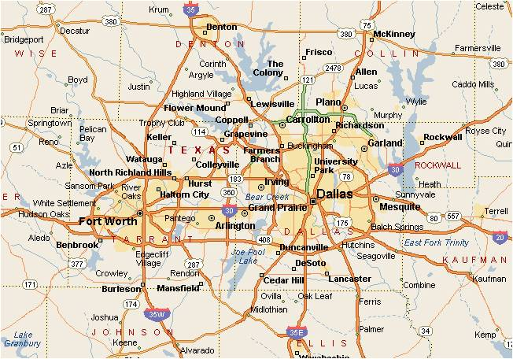
Dallas-Ft. Worth metroplex

Slide 9
Higher studies in USA (MS, PhD, MBA …)

Slide 10
CS & Engineering education: USA vs. India
USA
Quality
India
college rank

Slide 11
Why study in USA?
Less competition: Relatively easy to get into high quality institutions
Value of US education in the industry
Different environment and culture
Bragging rights? ☺

Slide 12
Hurdles to clear: Admission, Visa & Finances
Financial burden:
Typical MS course cost right now: $4K * 12 = $ 48K * 44 → Rs. ~20 lakhs
Less # of assistantships due to budget issues
Bit arcane US visa approval process & uncertainty
Plan ahead for TOEFL and GRE tests
Convincing yourself & parents ☹

Slide 13
Improving your chances
Do some thing additional to coursework
Need not be earth-shattering invention
Start with papers in collegiate symposiums
Work with industry during Summer break
Work on your own interesting projects or contribute to open-source projects
Sell yourself : Record everything in your admissions paperwork

Slide 14
Interested in Ph.D.?
Once admitted, you will get favorable treatment in most universities
Full-time MS followed by full-time job & part-time PhD is a good compromise
enables you to make informed decision
want to become professor?
continue research to get tenure (permanent job)
takes 3 to 6 years

Slide 15
Miscellaneous notes
Once you complete one semester, your GPA will be the only item that matters!
Hard to get assistantships for first semester
You can start working after 2 long semesters
Easier to convince professors for RAs after you do well in their courses
Get help from your seniors
Apply to varied set of 5 to 10 colleges

Slide 16
Job opportunities in USA

Slide 17
Job opportunities in USA
Environment favorable for foreigners
Population too worried about outsourcing
American students view it as nerdy
Recent study shows that SW Engineer is one of the best jobs in the world
Direct job in US companies requires US degree
Salary figures:
~$60K (freshers) - Rs. 2 lakhs/month
~$100K (~5 years experience) – Rs. 3.5 lakhs/month

Slide 18
Software related job opportunities in USA
Internships will help to get full-time quicker
Direct job in US companies requires US degree
Almost every CS graduate gets a job
US degree will get you job almost anywhere
Typical employee changes job every 2-3 years once – but visa status may complicate it.

Slide 19
Software Outsourcing
Goal: reduce cost
Projects need to fit certain criteria
Bit formal & clear requirements
Interfaces well defined/understood
should be of reasonable size
Not a good idea for small/poorly defined/time-critical/security-sensitive projects
Opinion: may stay at current level or go down
Industry not conducive for more outsourcing
With increased cost, Indian SW companies under pressure

Slide 20
Software jobs in India
Plenty of jobs for foreseeable future
“Core” development of complex projects done here, not in USA. Example: Samsung
Work hours and professionalism worrisome
Take care of your health!

Slide 21
Trends in CS education

Slide 22
Trends in CS education
Difficulty in attracting US students to CS
Introduction to Programming : going visual
Alice, Scratch, …
Java dominates in CS1 & CS2 courses
C++ used to teach pointers & memory management
Industry projects in the final year
Online courses becoming popular, augmenting education landscape
Lots of online multimedia lectures in the web
serious Game design programs on the rise – lot of focus on efficiency unlike business applications
Smart-phone applications (iPhone & Android)

Slide 23
Higher education in India
Attended T4E conference in IIT Chennai, July 14-16 and met several educators.
Lot of concerns about quality of higher education, but not many answers
Online course materials:
MIT Open courseware http://ocw.mit.edu
NPTEL National Programme for Technology Enhanced Learning http://nptel.iitm.ac.in/

Slide 24
Trends in Software Development

Slide 25
Complexity of software projects: historical snippets
Ad-hoc development model
Waterfall model
slow & unpredictable
heavy documentation effort
cost overruns & missed deadlines

Slide 26
My experience with huge SW projects (Waterfall model)
Period of instability
collisons during merge
product delays
Is it good enough to release?

Slide 27
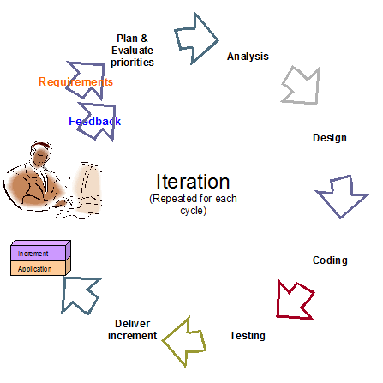
Agile process

Slide 28
Agile methods
Limited documentation
Better tracking of current status
Frequent releases
Continuous interaction with the customer
Several refinements: XP, SCRUM, …

Slide 29
A typical industry project in 1990
New code
C standard library
Home-grown library

Slide 30
Same industry project NOW
New code
Home-grown library
Commercial libraries for industry segment
IDE modules
Open source components
C++/Java standard library
Follow-up Q: Any disadvantages? Follow-up Q: How one becomes experienced programmer?

Slide 31
Questions
Expert programmer: what does it mean?
Future projects: No code? Just integration?
Knowledge of Java/C++/… down the drain?

Slide 32
Application Specific Programming
script
script
script
…
Intrepreter
M1
M2
M3
Mn
…

Slide 33
Data Exchange
A2
A1
A4
A3

Slide 34
Data Exchange
Binary or text data → XML or JSON …
Independent data checkers tools available.
A2
A1
A4
A3

Slide 35
Software Outsourcing
Goal: reduce cost
Projects need to fit certain criteria
Bit formal & clear requirements
Interfaces well defined/understood
should be of reasonable size
Not a good idea for small/poorly defined/time-critical/security-sensitive projects
Opinion: may stay at current level or go down
Industry not conducive for more outsourcing
With increased cost, Indian SW companies under pressure

Slide 36
Design decisons
Purchase modules or use open-source?
.NET or Java?

Slide 37
Software efficiency: Do we really care?
Goal is to make software work & meet deadline for most industry projects.
Game console: Algorithm takes longer to run → requires higher-end CPU to keep realism → higher price → product fails amid competition
Web-server: Algorithm takes longer to run (consider 5 seconds vs. 20 seconds) → tests web-users’ patience & requires more web server capacity.
Daily data crunching: What if it takes >1 day?

Slide 38
A few more points …
Standalone applications → Enterprise bundles
Local SW installation → intranet based
Build in-house → Buy & customize
Heavy text based coding → visual programming (GUI builders & debuggers …)
Desktops → Laptops → Smartphones

Slide 39
SW projects: Multi-dimensional problem
Companies want to complete Software Projects with
Smaller team
Limited resources
Higher quality
Reduced cost
On-time delivery
This is what each project manager tries to do ☹

Slide 40
Smart-phone development
My kids know/play games in Android phone
For me, email, calendar and contacts are in sync with company data
Question: can we do more with them?
Industry trend is to port several meaningful business applications to smartphones.
Example for cross-platform development

Slide 41
Game development
Lot of interest in real-time action games
Most games done in C/C++ in Los Angeles area
Algorithm optimization at work!

Slide 42
Summary
Software will continue to be growth area
More exciting things yet to come
Put your brain and passion to work!
Do not get scared by all the jargons/terms – basics are simple beneath the complex terms!
Try to enjoy the job & live a balanced life. Keep emotions away from the job.

Slide 43
Final year projects

Slide 44
Typical expectations
Of reasonable complexity
utilizes several concepts/components learned in the course
can be used in industry
uses several meaningful design & test tools.

Slide 45
Typical projects
Database and rich front-end
Smartphone application
Reasonably complex game
e-Process

Slide 46
Sample projects from UTDallas
PowerPoint Presentation Builder
Web-based configuration editor
Restaurant Management
Check-out using Smart-phone

Slide 47
Thanks for attending!
Dr. Jeyakesavan Veerasamy
jeyak7@gmail.com
jeyv@utdallas.edu

