Slide 1
Dr. V. Jeyakesavan: Academia, Industry & Personal
Dad was a school teacher
B.E. (ECE) in CEG Guindy, Anna University – 1986-90
UNIX System Software Engineer, HCL Limited, Chennai, 1990-91
MS Computer Science, University of Texas at Dallas (UTD), USA, 1991-94

Slide 2
Dr. V. Jeyakesavan: Academia, Industry & Personal …
Telecom Software Engineer, Northern Telecom, Dallas, 1994-97
Ph.D. Computer Science (part-time), University of Texas at Dallas (UTD), 1994-99
Technical Lead, Samsung Telecom, 1997-2010
Got married in 1998
Adjunct Faculty, UTD CS department, 1999-2002
Online Adjunct Faculty in several online universities from 2000

Slide 3
Dr. V. Jeyakesavan: Academia, Industry & Personal …
Adjunct Faculty, Southern Methodist University, 2010
Sr. Lecturer (full-time), UTD Computer Science, 2010-present
2 daughters: Nila (8) and Chinmayee (5)
Passionate about teaching – happy to share ideas to improve teaching quality in colleges

Slide 4
Dr. V. Jeyakesavan: Summary
18 years experience as Software Engineer
12 years of teaching experience

Slide 5
Background: Education
B.E. (ECE) | College of Engineering Guindy, Anna University, Chennai
9th - 12th | St. Xaviers Hr Sec School, Palayamkottai
8th | Govt Hr Sec School, P.Ramachandrapuram, village near Srivilliputtur
6th & 7th | Nadar Hr Sec School, Rajapalayam
5th | AKDR Elementary School, Rajapalayam
1st - 4th | Kasturi (Govt) Primary School, P.Ramachandrapuram, village near Srivilliputtur

Slide 6
University of Texas at Dallas
Erik Jonsson School of Engineering and Computer Science
Surrounded by 1000s of companies in Dallas-Fort Worth metroplex
Students can get internships right after 2 semesters and continue studies in parallel.
Most graduate students “graduate debt-free”!
We have well-ranked management school too.

Slide 7
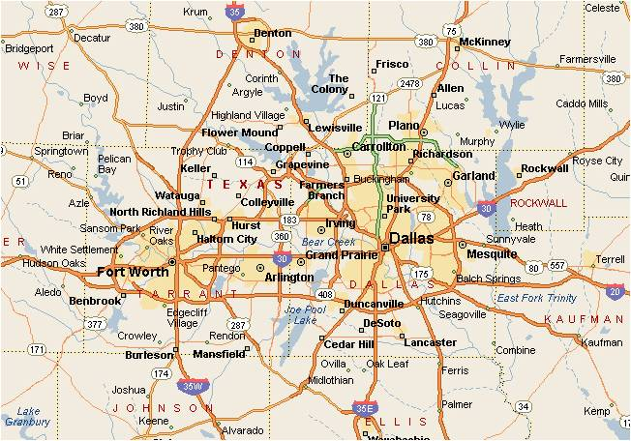
Dallas-Ft. Worth metroplex

Slide 8
UT Dallas: Indian connection!
More than >50% CS faculty are Indian.
Around 60% of graduate students are Indian.
Management school is named after an Indian: Naveen Jindal School of Management!

Slide 9
CS Department: Highlights
The UTD CS dept started as a small program within the Mathematical Sciences in the 70s
One of the largest CS dept’s in the US today
55 faculty members
120+ Research and Teaching Assistants
15 Staff members including 4 Tech. Support
1500+ Students (130 Ph.D. +700 MS +720 BS)
Full range of programs in CS, SE and TE:
-- BS, MS and Ph.D.
________________________________________________________________________
Department of Computer Science Jonsson School of Engineering and Computer Science

Slide 10
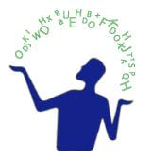
CS Department: Research Centers/Institutes
Cyber Security and Emergency
Preparedness Institute (DFEPI)
(Exec. Director: Dr. Doug Harris)
- Cyber Security Research Center
(Director: Dr. Thuraisingham)
Embedded Software Center (ESC)
(Director: Dr. Farokh Bastani)
Human Language Technology
Research Institute (HLTRI)
(Director: Dr. Sanda Harabagiu)
________________________________________________________________________
Department of Computer Science Jonsson School of Engineering and Computer Science

Slide 11
CS Department: Accomplishments
Ranked 29th in UC Irvine’s publications ranking of CS graduate programs
Ranked 24th worldwide in UC Irvine’s publications ranking of SE graduate programs
8 of our faculty hold Young Investigator awards
Top 5 producer of CS degrees
Placed 14th worldwide in ACM Programming Competition (just behind MIT & CalTech in US)
________________________________________________________________________
Department of Computer Science Jonsson School of Engineering and Computer Science

Slide 12
CS Department: Distinguished Faculty
Over 55 memberships on editorial boards of computer science journals
Research expenditure over $16 million in last two years
Published 250+ papers last year
Involved in numerous leading technical conferences as conference chairs or program committee chairs/members
________________________________________________________________________
Department of Computer Science Jonsson School of Engineering and Computer Science

