Slide 2
PROJECT PRESENTATION - PHASE 2
System Requirements Specification
INSTRUCTOR : Dr. LAWRENCE CHUNG
TEACHING ASSISTANT : RUTVIJ MEHTA

Slide 3
INTRODUCTION
Problem
Process
Product
Changes from Phase 1
Demo
Why we are better

Slide 4
PROBLEM

Slide 5
PROBLEM STATEMENT

Slide 6
PROBLEM STATEMENT

Slide 7
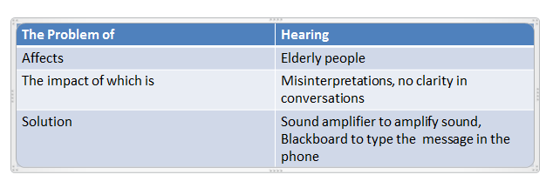
PROBLEM STATEMENT

Slide 8
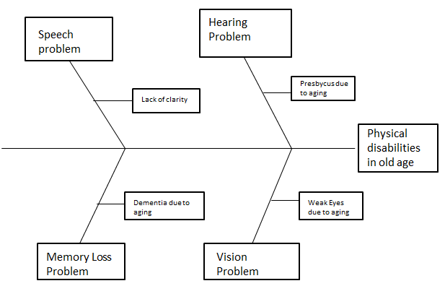
FISHBONE DIAGRAM

Slide 9
PROCESS

Slide 10
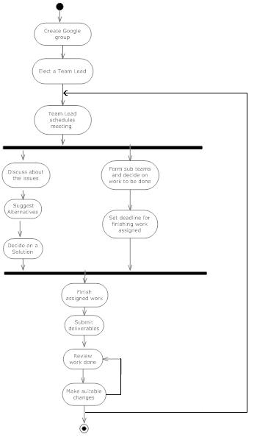
ACTIVITY DIAGRAM

Slide 11
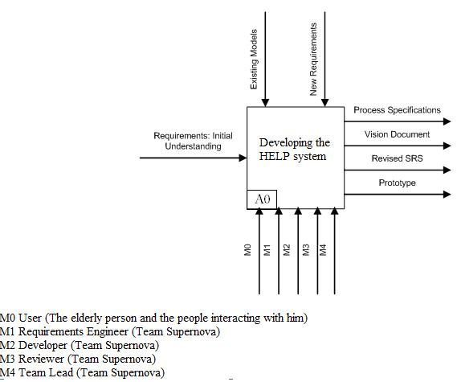
SADT DIAGRAM LEVEL 0

Slide 12
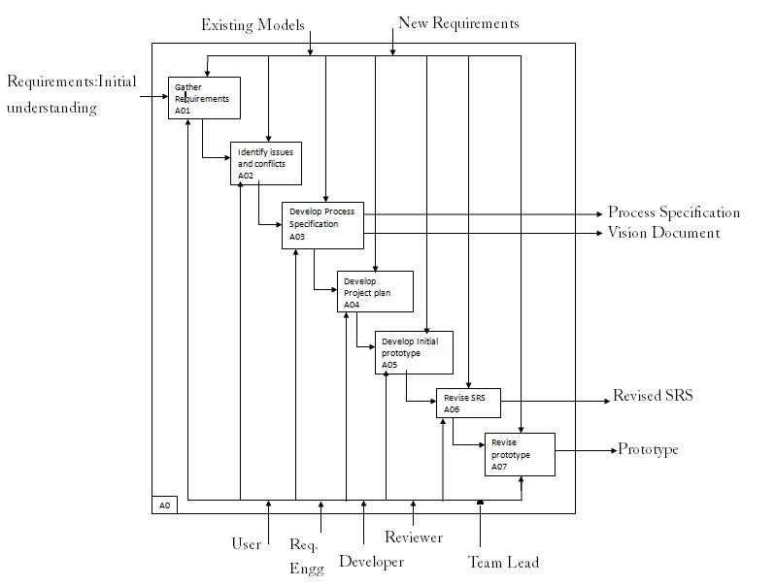
SADT DIAGRAM LEVEL 1

Slide 13
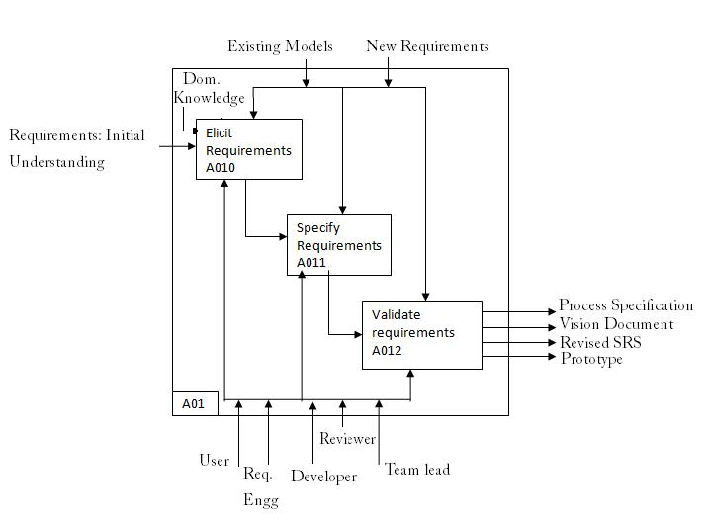
SADT DIAGRAM LEVEL 2

Slide 14
PRODUCT

Slide 15
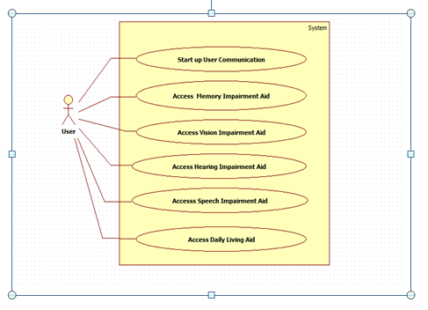
HIGH LEVEL USE CASE DIAGRAM

Slide 16
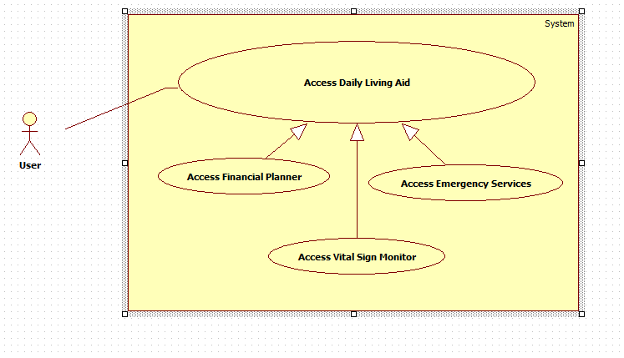
SPECIFIC VISUAL USE CASE DIAGRAM

Slide 17
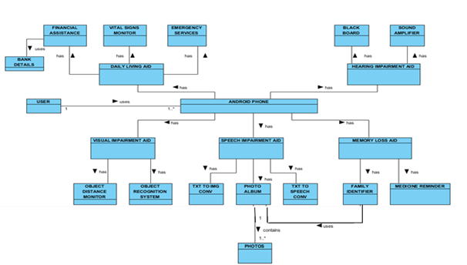
CLASS DIAGRAM

Slide 18
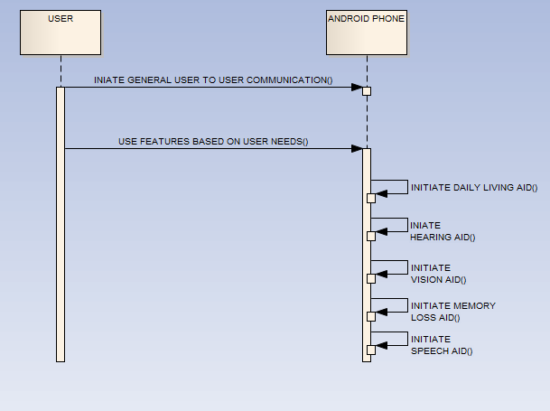
SEQUENCE DIAGRAM

Slide 19
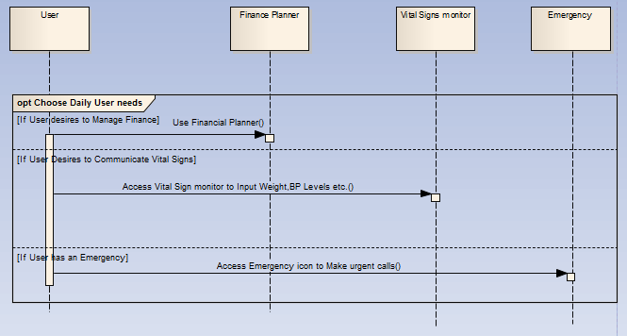
SEQUENCE DIAGRAM

Slide 20
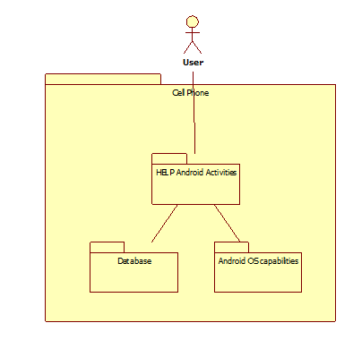
HIGH LEVEL ARCHITECTURE

Slide 21
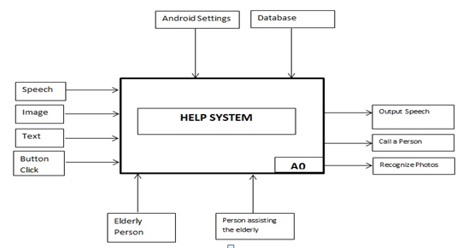
SADT LEVEL 0 DIAGRAM

Slide 22
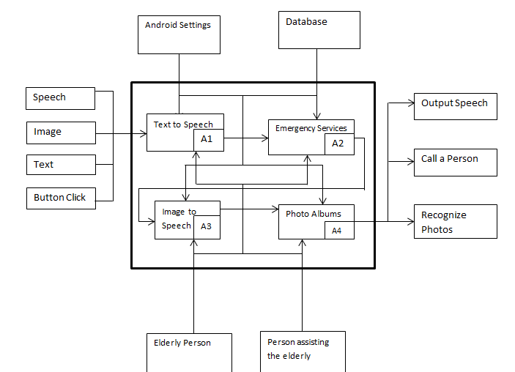
SADT LEVEL 1 DIAGRAM

Slide 23
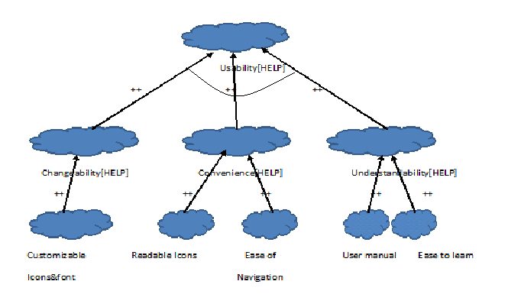
SIG - USABILITY

Slide 24
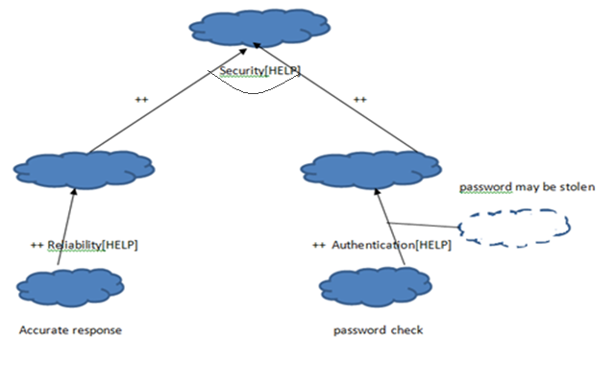
SIG - SECURITY

Slide 25
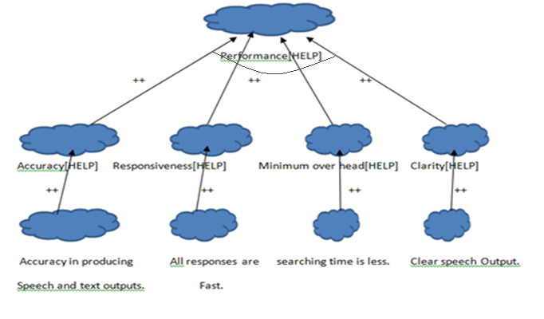
SIG - PERFORMANCE

Slide 26
CHANGES FROM PHASE 1

Slide 27
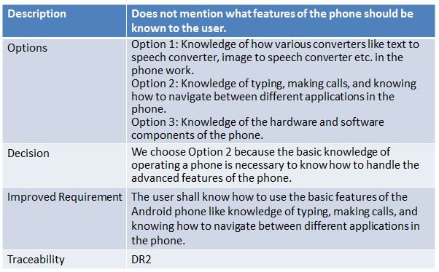
DOMAIN REQUIREMENT ISSUE - INCOMPLETE Requirement: The user shall know how to use the basic features of the Android phone.

Slide 28
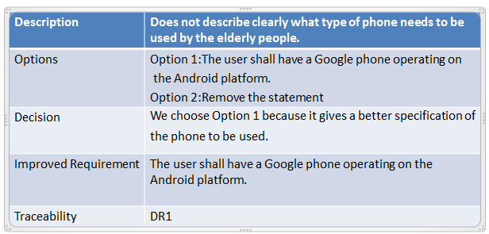
DOMAIN REQUIREMENT ISSUE - AMBIGUITY Requirement: The user shall have an Android Phone

Slide 29
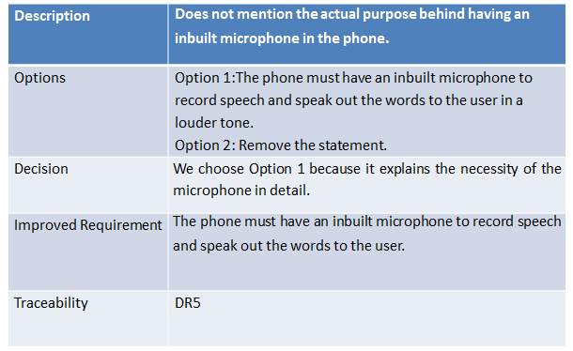
DOMAIN REQUIREMENT ISSUE - INCOMPLETE Requirement: The phone must have an inbuilt microphone to record speech

Slide 30
FR ISSUE – INCOMPLETE, AMBIGUITY
The call for help feature will allow the user to select from the emergency services, family and their assistant and puts them in touch within 10 seconds.
Description | The above statement does not clearly specify how the user selects from emergency service and other emergency services provided
Options | Option 1: User selects by clicking a button. Emergency service for 911, family, assistant and doctor are provided. Option 2: User selects by using voice command. Option 3: Provides emergency services for friend, relative etc.
Decision | We choose Option 1 because the requirement needs to be more specific where the user clicks on either family, 911, assistant or doctor and emergency service immediately dials to that particular number within 10 seconds.
Improved Requirement | Emergency service feature shall help the elderly person to call 911, family, doctor and or assistant in case of emergency using a button click rather than searching for the contact or dialing the number of person within 10 seconds.
Traceability | FR11

Slide 31
FR ISSUE – INCOMPLETE
The medical device monitor will allow elderly people to send their vital signs data from remote devices such as a weighing scale, sphygmomanometer and cardio belt to the smart phone via Bluetooth, where it is saved in the same format in which it is received and maintaining the case history of patients.
Description | Does not specify whether vital signs are sent to the doctor and if so in what way the data is sent.
Options | Option 1: Vital sign readings are sent to the doctor using text or email. Option 2: Vital sign readings are sent to the assistant for review. Option 3: Vital sign readings must be stored in server.
Decision | We choose Option 1 because vital signs received from the remote device must be sent to the doctor to analyze patient’s history using email or text.
Improved Requirement | The medicine device monitor will allow elderly people to send their vital signs data from remote devices such as weighing scale, sphygmomanometer and cardio belt to the smart phone via Bluetooth, where the data is saved in the same format in which it is received and then data is sent to the doctor via text or email. Data of the vital signs is stored in the smart phone to analyze the case history of patients.
Traceability | FR12

Slide 32
FR ISSUE – American Sign Language
Description | The vocabulary should also include sign language icons for people who may not have speech capability at all and may be well versed in American Sign Language (ASL) symbols
Options | Option 1: Add all American Sign language Symbols and spell them out Option 2: Add symbols for alphabets A – Z and spell them out Option 3: Add symbols for A –Z and when clicked display them to text area and spell them out.
Decision | We choose Option 2 because of time and resource constraint.
Improved Requirement | Elderly people with no speech capability or unclear speech and well versed in ASL can use symbols to spell out the alphabets on clicking the particular alphabet symbol.
Traceability | FR4

Slide 33
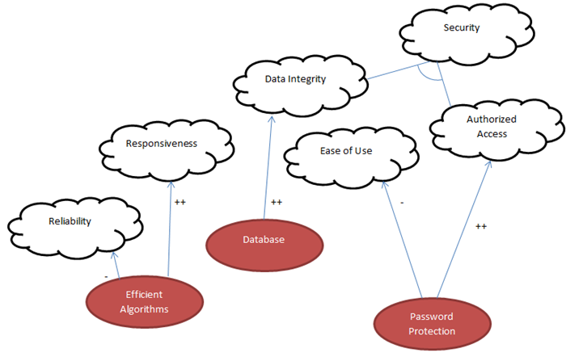
NON-FUNCTIONAL

Slide 34
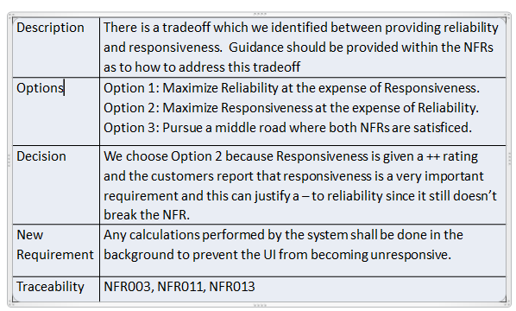
Issue IN+001 – Tradeoff between Reliability and Responsiveness

Slide 35
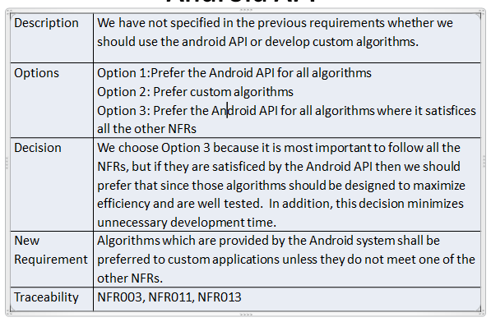
Issue IN+003–PREFERENCE FOR ANDROID API

Slide 36
WHY ARE WE BETTER?
All disabilities considered
Systematic Decision Making
Traceability
Spiral Model
Pareto principle
Version Control

Slide 37
WHY ARE WE BETTER?
Key Features:
Emergency Service
Medical Device Monitor
Finance Planner
Medication Reminder
Photo Album
Sign Language

Slide 38
DEMO

Slide 39
Any Questions??? Thank You…

