Slide 1
The Therac-25: A Software Fatal Failure
Kpea, Aagbara Saturday.
SYSM 6309
Spring ’12
UT-Dallas

Slide 2
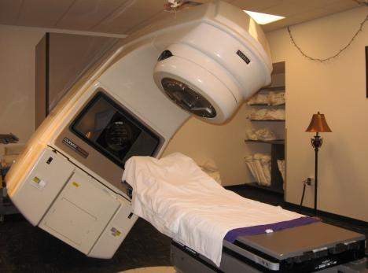
What is the Therac-25 ?
The Therac-25 was a medical linear accelerator, used to treat cancer
patients to remove
tumors.

Slide 3
Background Information
Early1970’s, AECL (Atomic Energy of Canada Limited)and a French Company (CGR) collaborate to build Medical Linear Accelerators (linacs).
They develop Therac-6, and Therac-20.
AECL and CGR end their working relationship in 1981.
In 1976, AECL develops the revolutionary "double pass" accelerator which leads to the development of Therac-25.
In March, 1983, AECL performs a safety analysis of Therac-25 which apparently excludes an analysis of software.

Slide 4
Background info …
July 29,1983, the Canadian Consulate General announces the introduction of the new "Therac 25" Machine manufactured by AECL Medical, a division of Atomic Energy of Canada Limited.
Medical linear accelerators (linacs) known generally as “Therac-25”.

Slide 5
What it does:
Medical linear accelerators accelerate electrons to create high-energy beams that can destroy tumors with minimal impact on surrounding healthy tissue
Shallow tissue is treated with accelerated electrons
Scanning magnets placed in the way of the beam; the spread of the beam (and thus its power) could be controlled by a magnetic fields generated by these magnets
Deeper tissue is treated with X-ray photons
The X-ray beam is flattened by a device in the machine to direct the appropriate intensity to the patient.
Beams kill (or retard the growth of) the cancerous tissues

Slide 6
Accidents with Therac-25
At East Texas Cancer Center in Tyler, Texas, a
patient complains of a bright flash of light, heard a frying, buzzing sound, and felt a thump and heat like an electric shock.
This indicates radiation overdose by Therac-25 machines after cancer treatment session
A few days after the unit was put back into operation, another patient complained that his face felt like it was on fire.
Another potential overdose of radiation beam by Therac-25.
Both patients died after 4months and 3 weeks respectively due to administered overdose of radiation

Slide 7
Causes of the Accidents
The problem was a race condition produced by a flaw in the software programming.
Management inadequacies and lack of procedures for following through on all reported incident.
Overconfidence in the software and removal of hardware interlocks.

Slide 8
Reasons for the cause of the accidents
Operator selected x-rays by mistake, used cursor keys to change to electrons
Machine tripped with “Malfunction 54”
– Documentation explains this is “dose input 2” error
Operator saw “beam ready” proceeded; machine tripped again

Slide 9
Requirements Issues
Error messages provided by Therac-25 monitor are not helpful to operators
Machine pauses treatment but does not indicate reason why
The equipment control task did not properly synchronize with the operator interface task, so that race conditions occurred if the operator changed the setup too quickly.
Software is required to monitor several activities simultaneously in real time
Interaction with operator
Monitoring input and editing changes from an operator
Updating the screen to show the current status of machine
There were no independent checks that the software was operating correctly (verification)

Slide 10
Recommendations
Documentation should not be an afterthought.
Software quality assurance practices and standards should be established.
Designs should be kept simple and ensure user-friendly interfaces
Ways to get information about errors, i.e., software audit trails should be designed into the software from the beginning.
The software should be subjected to extensive testing and formal analysis at the module and software level.
System testing alone is not adequate; verification would be very valuable.
Involve users at all phases product development

Slide 11
References
The Therac-25 Accidents (PDF), by Nancy G. Leveson (the 1995 update of the IEEE Computer article)
http://en.wikipedia.org/wiki/Therac-25

