Slide 1

Memory Management in Modern Computers
One of the biggest problems facing modern computer designers is that of providing large amounts of high speed memory.
This is a problem that has evolved over the last 30-35 years.
Earlier in the history of computing, most processors were relatively slow compared to the speed of available memories (Except for bulk storage mechanical memories, i.e., disks and drums).
Especially in the early days of the personal computer, the CPU was relatively slow compared to early electronic memories.
The speed of random-access memory was not an issue; the biggest problem was just getting enough memory, period (early PC’s with large memories had 256-512 Kbytes)!

Slide 2
Relative Speeds of the CPU and DRAM
Over the last three decades, central processor chips have caught up with and passed DRAM speed dramatically.
Example: current CPU speed is 3-5 GHz, depending on the processor type, and should increase somewhat, although manufacturers are now abandoning the “speed race” in favor of multiple processors.
On the other hand, practical bus speed for CPU memory is about 1-2 GHz currently, and this is for “high performance” memory; “common” bus speeds are still no more than half that.
The CPU performance edge over memory is on the order of 2-4, and much more than that on systems with the more common bus speeds.

Slide 3
The Memory Speed/Cost Dilemma
There are further problem facing the modern computer designer:
  Users need very high memory speeds to improve performance (for example, in graphical computing, games, video editing).
  At the same time there is also great demand for maximum memory capacity by many users (PC’s do not just manipulate text any more; complex graphics, video games, movie editing and animation all require enormous amounts of both DRAM and bulk storage (hard drives or solid-state memories).
However, there is a conflict in these requirements:
  Fast memories are very expensive.
  High-capacity, cheap memories (HDD’s/SSM’s) are very slow.

Slide 4
Stating the Memory Management Problem
The computer designer of today is therefore faced with a problem that is not easy to solve:
  There must be enough high-speed memory (i.e., “cache”) to avoid slowing down the processing rate of current CPU’s.
  There must be sufficient DRAM to avoid the deadly “disk access” (i.e., having to go to the HDD/SSM to retrieve data), since these memories are lethargic in access time).
  There must be enough bulk memory (HDD/SSM) for all storage needs, and accessing this memory and transferring it to DRAM/other memory must be as painless as possible.
  The cost must be reasonable.

Slide 5
Solving the Problem of Memory Management
The current approach to memory management :
  CPU has a large register complement (improves performance).
  Very-high-speed D flip-flop arrays, called cache, hold currently executing program and data segments. Types of cache :
    L1/L2 cache – Adjacent to ALU. ~ 32-64 Kbytes, very fast.
    L3 cache – Center of CPU chip. ~ 15+ Mbyte, very fast.
  High-speed electronic memory (“DRAM,” up to 256 Gbytes, fast) provides capacity for programs currently in process.
  Bulk storage memory (SSD’s/SSM’s), ~0.3-32+ TByte, slow but cheap) for program storage and “near-term” archives.
  Slower memories such DVD’s for long-term storage.

Slide 6
Types of Memory
As we have just seen, even in the everyday PC, the use of sophisticated memory management is common.
Thus there are four kinds of memory in the modern PC or workstation: Registers, cache, DRAM, and HDD/SSM. And this does not count DVD’s, thumb drives (flash EPROM), or even (!) floppy disks (5 billion floppies sold in 2016)!
The challenge to the computer engineer is to mesh the first five storage media and to make the use of them “transparent” – that is, invisible to the user, who will appear to have massive amounts of high-speed, cheap memory available to solve any problem.
Before we discuss how to manage this extremely challenging engineering problem, we will discuss the types of memory that are used and learn a little about them.

Slide 7
Registers
D
C
Q
R
D FF
32-Bit Reg.
Register Block
We already know that registers are simply collections of D FF’s.
Most CPU’s today contain many registers, (e.g. the R-2000’s 32).
Registers are inside the CPU, adjacent to the ALU, so their speed is basically that of the CPU (in fact, they determine ALU speed).

Slide 8
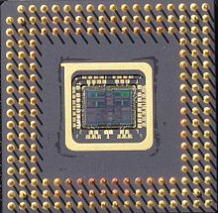
Later-Gen MIPS With Registers
Later-generation MIPS
(“Orion”) processor showing multiple registers (fixed and floating point)
Register area

Slide 9
Random-Access Electronic Memory
Random-access memories (RAM) make up the “working memory” of most computers.
These memories are referred to as “random-access” because the entire array of memory is immediately available to be used; any single byte in the memory may be loaded or stored (“randomly accessed”) in the same amount of time.
There are two primary types of RAM: Static RAM (SRAM), and dynamic RAM (DRAM). Both SRAM and DRAM are used in modern computers such as the PC.
SRAM is used in what are referred to as caches—small, very-high-speed memories that are physically close to the CPU.
DRAM, though very fast, is slower than SRAM, but because it is inexpensive, it is the primary memory in most personal computing systems.

Slide 10
L1 Cache
L1 cache (“level 1 cache”) is SRAM memory that is very close to the CPU. For example, it is next to the ALU in most processors.
L1 cache is basically sets of D FF’s, but many more than in the CPU register block.
For example, a typical register block might have 16-32 registers of 4 or 8 bytes each for a total of 64-256 bytes of storage. The Intel L1 Core i7 cache, on the other hand, has 64 Kbytes (32K instruction, 32K data)– the equivalent of ~ 500,000 flip-flops.
Access speed of L1 cache is slower, however, due to the complex arrangement of data buses which is necessary to access specific bytes in the L1 memory array. It is typically about 1/2-1/3 as fast as CPU registers in terms of load/store cycle.

Slide 11
L1 Cache (Continued)
D
C
Q
R
D FF
32-Bit Reg.
L1 Cache
As you saw on the previous slide, in terms of memory structure, cache has regressed. Modern computer chips have separate instruction and data caches!

Slide 12
L2 Cache
The level-2 cache is a bit farther away on the chip. (L2 is also SRAM).
L2 cache is much larger, since more “real estate” is devoted to memory. The Intel Core i7 has 1 Mbyte L2 cache.
Due to even more elaborate bus arrangements and the fact that L2 cache is not as close to the ALU, load/store access is > L1 cache.

Slide 13
L3 Cache
In modern multicore processors, the cores share the L3 cache, which is typically 8-15 Mbyte, or even more in some cases.
As L1 cache is slower than the register block, and L2 is slower than L1, L3 cache is slower still, though much faster than DRAM. The reason is that the L3 cache is even farther away from the ALU, though still on-chip.
To minimize the degradation in memory speed, the CPU’s are typically clustered around the L3 cache, as shown in the picture of the Core i7 chip (upcoming).

Slide 14
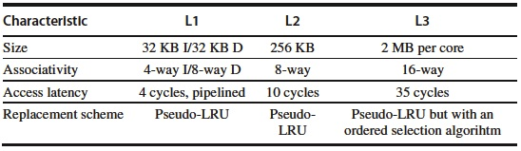
Intel Core i7 Cache Structure

Slide 15
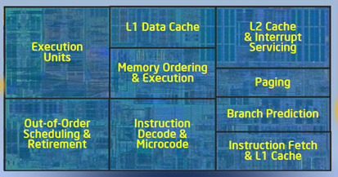
Processor Layout of Single Intel Core i7 CPU

Slide 16
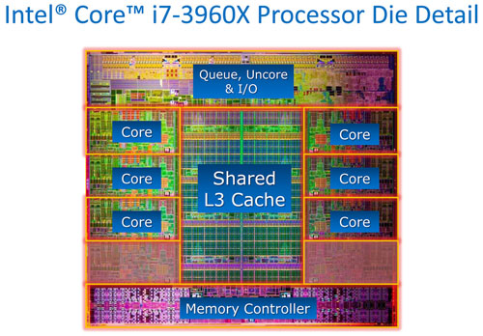
Cache Location on Intel CPU

Slide 17
Why Not More Cache?
The question arises: If cache memory is so great, why isn’t all computer memory fast cache?
Answer: Cache memory has two major problems:
  It consumes huge amounts of power compared to DRAM memory (a flip-flop has about sixteen transistors; a DRAM cell uses only one).
  This means if more cache were used, the cost of a computer (think PC) would go up dramatically, due to the cost of extra power to run it, and cost of cooling the computer!
  Also, cache is much more expensive than DRAM (5:1 or more).
For that reason, DRAM memory is an excellent compromise solution to fast storage problems.

Slide 18
Comparison of SRAM and DRAM
SRAM
Very fast
High; ~16
transistors
per storage cell
High
Excessive
High
Parameter
Speed
Complexity
Power Used
Heat
Generated
Cost
DRAM
Fast
Low; 1
transistor
per cell
Very low
Virtually
none
Very low

Slide 19
DRAM Memory
The term DRAM stands for “dynamic random-access memory” (pronounced “D-ram,” not “dram”). This means that the title above is actually redundant!
DRAM is electronic memory that is capable of very fast access (load or store), but is not as fast as cache. One exception is “Rambus” memory, a special DRAM memory whose manufacturer has announced cache-speed products (up to 7.2 GHz!). It is very expensive, however.
The simple construction of DRAM makes it ideal in modern, workstation-based computing, where most users have their own computer system (PC, Mac, Sun, etc.).
DRAM consists of a simple charge-storage device (stored charge = “1”), with a switch to store/test the charge. Only a single transistor is required for a DRAM bit cell.

Slide 20
DRAM (Continued)
The term “dynamic” in DRAM is due to the fact that the memory is not truly a flip-flop; it is not static. DRAM “remembers” a 1 by storing charge on a capacitor.
Capacitors, however, are not perfect storage elements – the charge leaks off after a short time. Thus the DRAM element is “dynamic” – its memory lifetime is limited and it must have its memory refreshed periodically.
On the next several slides, we explore the way DRAM is constructed and the odd way that it must be treated to be sure that it retains its memory.

Slide 21
DRAM Memory Cell Construction
Bit line
CMOS
transistor
Word
line
Capacitor
Ground
The DRAM cell is quite simple, consisting of a single CMOS transistor and a capacitor, which can store electronic charge.
The capacitor is grounded on one end. Wires connect two terminals of the transistor to lines that can apply voltage.

Slide 22
DRAM Cell Operation
Bit line
+V (= logic “1”)
Bit line
0V (= logic “0”)
Current
Current
+V (= logic “1”)
turns on
transistor
+V (= logic “1”)
turns on
transistor
CMOS
transistor
CMOS
transistor
Word
line
+
Capacitor
charges
Word
line
0
Capacitor
discharges
Ground
Ground
To “write logic 1 data” to a DRAM cell, a voltage is applied to the word line, which turns the transistor on (it is like an “electronic switch”). If a voltage V is applied to the bit line, current flows into the capacitor and charges it, creating a “logic 1.”
To “write logic 0 data” to a DRAM cell, a voltage is applied to the word line, which turns the transistor on (once again, like an “electronic switch”). Now, if 0 volts (“ground”) is applied to the bit line, current flows out of the capacitor and discharges it, creating a “logic 0.”

Slide 23
DRAM Cell Operation (2)
Bit line
logic “1” sensed
Bit line
logic “0” sensed
No current flow
Current
+V (= logic “1”)
turns on
transistor
+V (= logic “1”)
turns on
transistor
CMOS
transistor
CMOS
transistor
Word
line
+
Capacitor
charged
Word
line
0
Capacitor
has no charge
Ground
Ground
Read 1 memory cycle.
Read 0 memory cycle.
To “read,” or sense the value of the DRAM cell, the word line once again has a voltage applied to it, which turns on the transistor. If the capacitor is charged, current flows OUT of the transistor, and this current is sensed and amplified, showing that a “1” is present. If the capacitor is discharged, no current flows, so that the sensing element determines that a logic 0 is present.

Slide 24
DRAM Cell Operation (3)
Note that in reading a DRAM memory cell with a “1” in it (charge stored on capacitor), the act of reading destroys the “1” by draining the charge off the capacitor.
Therefore, after reading a “1,” it must be rewritten.
Also, as time passes, whether used or not, the capacitor loses charge so that the logic “1” eventually disappears.
We see that even if a 1 is not read, the charge must be periodically replaced or the DRAM memory “loses its mind!”
In a modern DRAM cell, this “refresh” must occur every few milliseconds.
The refresh cycle is not long, however, taking 4-5% of total memory read/write time, which does not reduce memory speed or efficiency to any great degree.

Slide 25
DRAM Cell Operation (4)
Bit line
Logic “1” read (or sensed in refresh cycle) by draining capacitor
Bit line
Logic “1” rewritten by applying +V to bit line
Current
Word line reactivated
Current
Word line activated
CMOS
transistor
CMOS
transistor
Word
line
+→0
Word
line
0→+
Capacitor
discharges
Capacitor recharged
Ground
Ground
Read 1 memory cycle or refresh cycle logic “1” detect.
Read or refresh cycle logic “1” rewrite.
The refresh cycle occurs after a logic 1 read or periodically if the memory cell is not accessed. The refresh cycle is typically every few milliseconds. Obviously if the cell is a 0, it is not recharged.

Slide 26
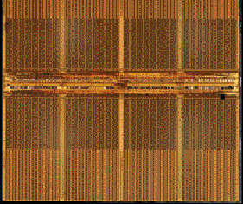
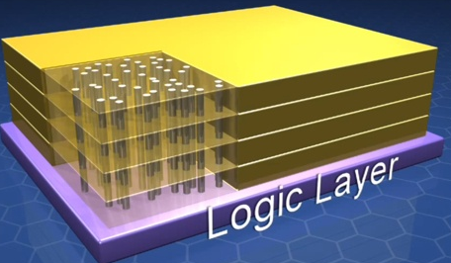
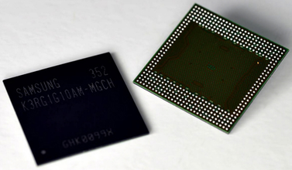
DRAM’s Get Denser
Current new DRAM systems top the scale at 64 and 128 GB (up to 4 GB per package)!

Slide 27
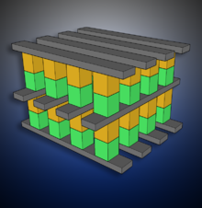
3-D Crosspoint NAND Flash
“In the next five years, we will start to see flash drives that are larger than current spinning disks by almost an order of magnitude.” (Intel quote on new flash technology.)

Slide 28
Exercise 1
Rank these memories by speed: L2 cache, DRAM, L1 cache, registers, and hard disk drives.
A DRAM memory chip is accessed and a bit read out. The bit that is read is a 1. What happens now?
That same memory bit is then left “alone” (i.e., not accessed by its addressing mechanism for either read or write) for several milliseconds. What happens next?

Slide 29
Exercise 1 Answers
(This will help with the Test #3 bonus homework) – Registers in the computer are adjacent to the ALU, L1 is on-chip, L2 is nearby, and DRAM and HDD are farther away from the CPU. Thus the speed ranking is registers, L1, L2, DRAM, HDD.
The 1 data is erased by the read, so that the 1 is immediately rewritten after it is read.
The capacitor begins to lose charge (the “1”) and so it is rewritten periodically.

Slide 30
Bulk Disc Memory Storage (“HDD”)
Electromechanical data storage is normally not random-access like SRAM or DRAM.
This means that data cannot normally be accessed in arbitrary order, but must be loaded or stored according to rules, which generally have to do with positioning a recording mechanism over the correct location in an expanse of recording media prior to being able to perform the memory access.
That is, the correct segment of data must be located (normally by mechanically moving a recording head) before it can be read.
This load/store operation is particularly time-consuming, because it involves mechanical movement rather than simply electronic switching.

Slide 31
HDD Read/Write Mechanism
Rotation
Strong, concentrated magnetic field
Aluminum disk coated with magnetic material
Magnetic field lines (direction depends on current flow)
Current flow
The HDD stores data on a rotating disk coated with magnetic material.
A magnetic coil is used to record each one and zero. Current in the coil generates a magnetic field, which magnetizes material in the HDD surface. One direction of current writes a 1, the other a 0.
When the coil is later positioned over the disk to read, the opposite-polarity 1’s and 0’s cause back-and-forth current flow according to whether a 1 or 0 is present. In this way, the data is detected.

Slide 32
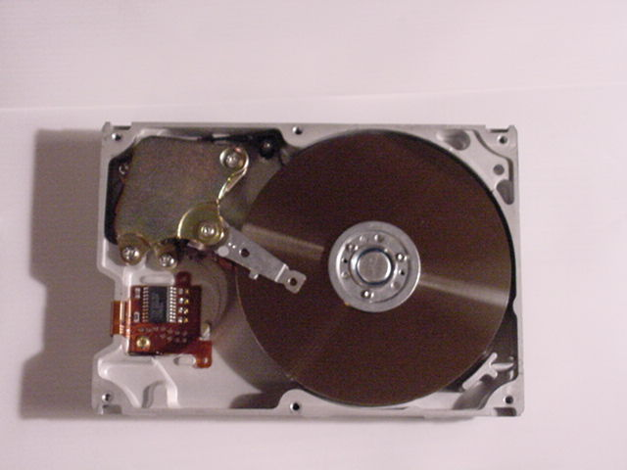
Hard Disk Drive Example
Portion of read/write electronic circuitry (the rest is on the back side of the unit on a separate circuit board).
Metal disk covered with magnetic coating
Recording head

Slide 33
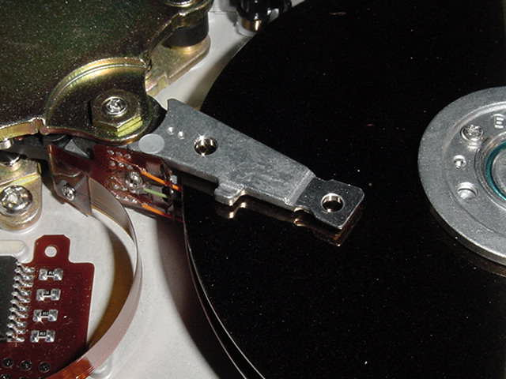
Detail of Disk Read/Write Head
Flexible cable carries signals to amplifier circuitry to be converted to digital signals
Positioning mechanism
Positioning arm
Recording head

Slide 34
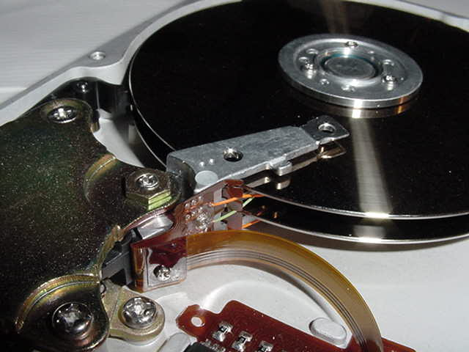
HDD Side View, Showing Multiple Disk Platters
Upper recording and reading head; note that positioning mechanism moves both heads simultaneously.
Second recording disk surface (recording head not visible)

Slide 35
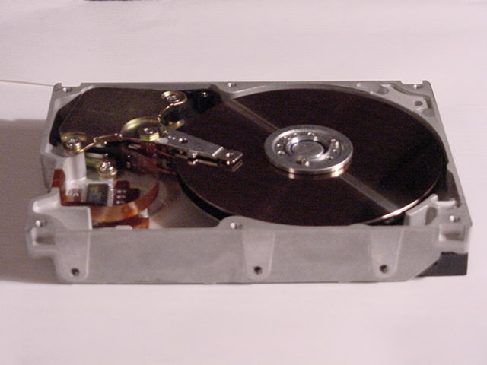
HDD Package
The HDD is usually packaged in a metal case. Higher-quality units are typically packaged in an aluminum casting, or similar rigid container, which provides stability and better data integrity.

Slide 36
HDD Storage/Retrieval is Slow
The latency (“time to get/store data”) of a HDD is given by the formula:
latency = seek time + rotational delay + transfer time + controller delay
  Where:
  Seek time = time for the positioning arm to move the head from its present track to the track where the load/store data is located.
  Rotational time = time for the requested sector to rotate underneath the read/write head after the head is positioned over the track.
  Transfer time = time for data transfer from disk to main memory.
  Controller delay = time to set up transfer in the HDD electronic interface.

Slide 37
HDD Storage/Retrieval is Slow (2)
Example: latency of writing one 512-byte sector on a magnetic disk rotating at 7200 rpm, with the following parameters:
  Average seek time = 12 ms (typical for movement across half the disk)
  Transfer rate = 5 Mbytes/sec; transfer time = [0.000512Mbyte/5 Mbyte/sec] = 0.1 ms
  Controller delay = 2 ms
  Rotational time depends on the position of the first byte to be transferred, but on average will be ([1/7200)]×60×[1/2]) = 4.2 ms (average rotation = ½ of circle).
Then average latency = 12 ms + 4.2ms + 0.1 + 2 ms = 18.3 ms. Note that actual transfer time is small!

Slide 38
Other Disk Storage Units and Media
Other storage media include flash memories or SSD’s, DVD’s and “thumb drives.”
Most of these storage units are removable media.
Floppy disks, hard drives, Zip drives, and tapes are magnetic media.
The CD-ROM and the DVD use optical recording/reading involving a laser beam to record and read data. They are relatively slow.
The “thumb drive” uses electronic memory called EPROM (“erasable, programmable read-only memory”), and is a true solid-state memory. These drives were the first “SSD’s.”
Very fast EPROM’s (SSD’s) are beginning to be available for fast bulk storage, replacing HDD’s on laptops. They are relatively expensive.

Slide 39
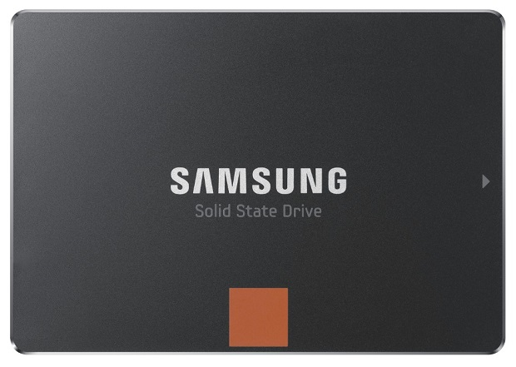
SSD’s Get Larger and Faster
In 2017, Samsung launched the SSD 860 QVO line. Models now come in 1, 2, and 4 TB’s; reviews have been very positive.
The best budget option is the SanDisk Ultra 3D SSD, at 1 TB, with lower performance and warranty.
WD Blue 3D SSD is also an economy option.

Slide 40
Biggest and Best SSD’s
The biggest affordable solid state drives available in at present:
  Samsung 860 QVO SSD Line: 4 TB—$600, 2 TB—$300, 1 TB—$149.
  WD Blue 3D SSD: 1 TB SSD—$119.
  Crucial BX300: (240GB)—$90.
  Toshiba TR200: 480 GB—$149, 240 GB—$89.

Slide 41
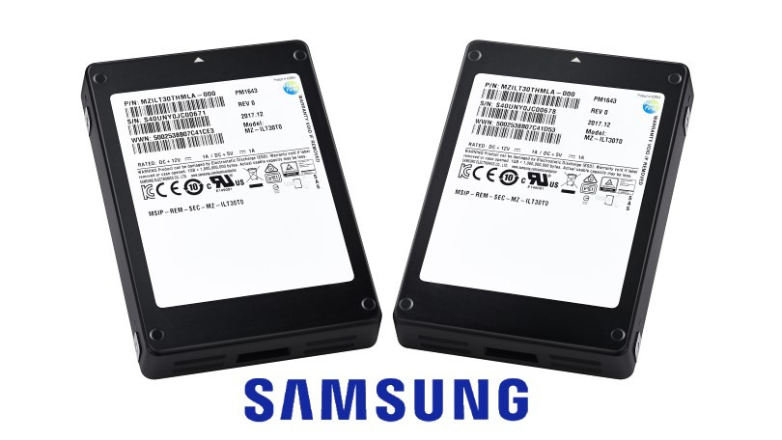
Samsung 30 Tera-Byte SSD
Price is ~ $12K

Slide 42
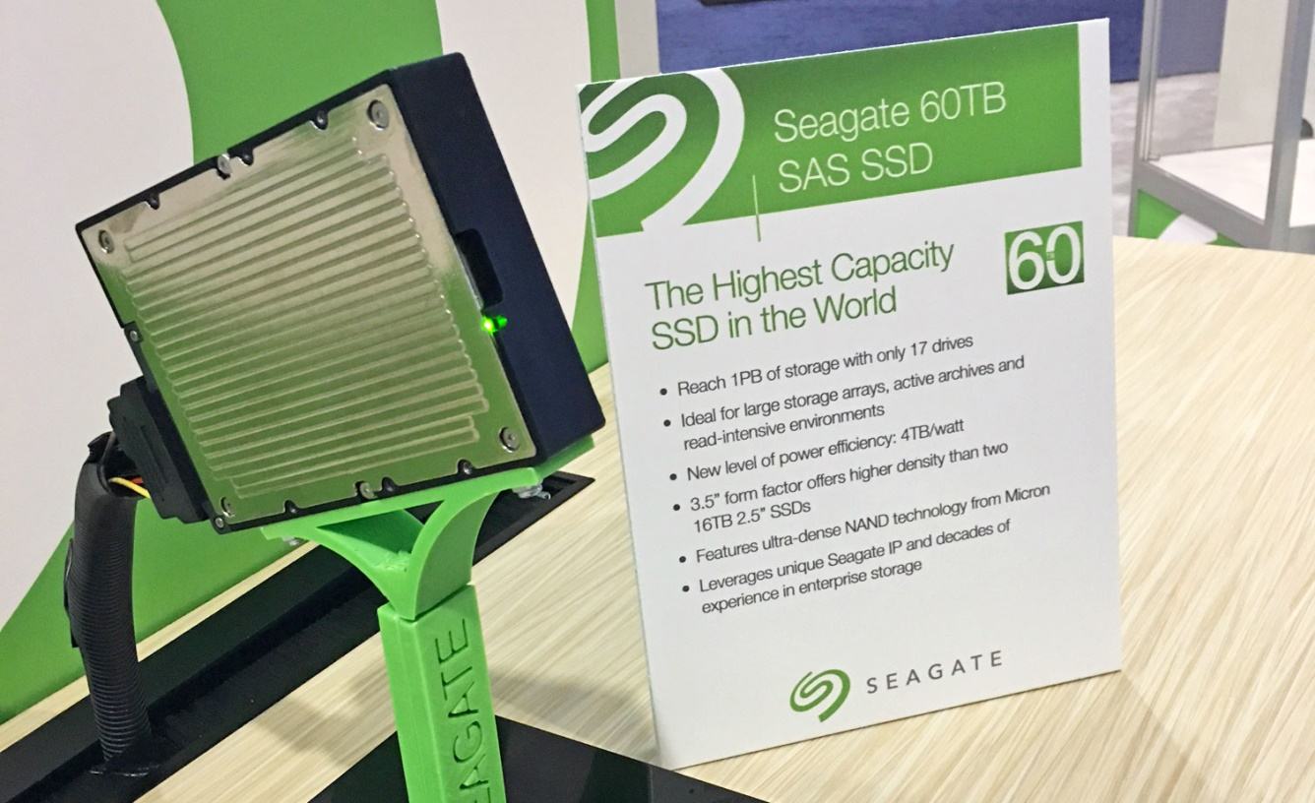
The Former Champion
Seagate SAS SSD: One of the largest—60 Tbyte!
Available as of December.
Price in the ($18K-20K) range.

Slide 43
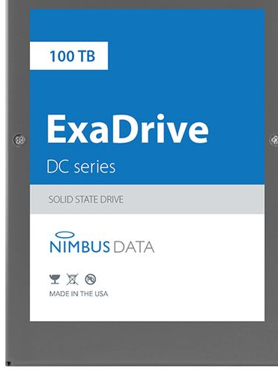
Newest SSD Champ!
Nimbus Data ExaDrive.
100 Terabytes!
Price is difficult to find, but probably in the $50,000 to $100,000 area!
Has a 5-year guarantee, very unusual for memory devices.

Slide 44
The Memory Hierarchy
We have described a number of memory devices which are useful for storing and reading computer data.
All of these (other than archival types) are used in a mix on the modern computer for real-time storage and retrieval of data.
Since SRAMs – the best data storage media if not so power-hungry and costly – cannot be used exclusively, a mix of L1 and L2 cache, DRAM, and bulk storage make up the “memory hierarchy” of most computers.
The trick is to design a mix of these types which will give the highest performance for a reasonable price.

Slide 45
Arrangement of the Memory Hierarchy
Memory arrangements make use of the fact that programs exhibit two common behaviors:
  Temporal locality – Recently-used code and data is often reused (e.g., a loop program continues to use the same steps).
  Spatial locality – Recently-accessed data items are usually close to other recently-accessed (or about-to-be-accessed) data items.
Modern schemes use a “shuffling” methodology that moves data from slower storage media to faster media.
Higher-speed memories are also placed closer to the CPU, since memory access also depends on the proximity of the storage element; electronic signals propagate at about 33 ps/cm.

Slide 46
Arrangement of Levels in Memory Hierarchy
CPU Package
DRAM
CPU
L1
Cache
L2/3
Cache
HDD
Registers
Size: <300 Bytes 8-64 Kbytes 0.5-3 Mbytes 0.5-4 Gbytes 160-2000 Gbytes Speed: 100 ps 200 ps 0.2-0.5 ns 1-10 ns ~10-20 ms
Memory is physically arranged so that fastest elements (registers) are closest to the CPU and slower elements are progressively farther away.

Slide 47
The Importance of Cache
As mentioned previously, the key to modern computer performance is not the CPU. CPU performance has far-outstripped the speed of most computer memories.
The key is the use of cache. The secret of today’s high-performance PC’s and workstations is the design of an architecture that allows maximum use of DRAM and SSM/HDD (cheap) plus just enough SRAM cache (expensive and power-consuming), thus enabling the CPU to realize most of its performance advantage.
The method used is the “shuffling” technique alluded to two slides back. This method uses a very high speed, complex arrangement to constantly move program and data content from slower to faster memory as the CPU executes a process.

Slide 48
Cache Utilization
Cache designers make use of the principles of temporal and spatial locality to assure that the most-probably needed instructions and data are available to the computer in cache (to speed execution).
Special hardware is designed to manage cache content with the goal of forecasting upcoming instructions and data required by the processor during program execution and moving it from slower DRAM into cache.
This hardware has two special goals: (1) examining the currently-executing process and predicting instruction and data needs, and (2) moving the required information from DRAM to cache in a timely manner to foresee that anticipated need.

Slide 49
Looking for Data/Instructions in the Cache
Clearly the purpose of cache management is to make sure that ALL upcoming instructions and data are in the cache.
This brings up two questions: (1) how does the processor know that data is in the cache, and (2) if it is NOT there, how does the processor get it and what sort of performance penalty is there?
There are several ways in which the cache can be assigned DRAM memory correspondence. The simplest is direct mapping, in which each block of memory in cache is assigned to some number of DRAM locations.
When a program needs a particular DRAM location to be loaded, it goes to the corresponding cache location to get the data. This leads to further complications, in that now we need “validity indicators” for each cache location. This is because since each cache block is assigned to several memory blocks in DRAM, the program needs to know if the right data is available in cache at the time it is needed.

Slide 50
Direct Cache Allocation
DRAM
Gigabytes
Megabytes
Any required data in 1 Meg Space shown always loaded into designated 1K space in cache.
Cache
1 KByte
1 MByte

Slide 51
Looking for Data (2)
If the correct data is not in cache, the hardware memory manager declares a “cache miss.” This means that the program must be delayed for several clock cycles while the required instruction or data is moved from DRAM to cache.
We see that a cache miss is highly undesirable, since it can substantially slow down the program.
A key part of cache memory management, then, is to minimize the cache misses, which correspondingly increases the speed of execution of a program.
There are a number of clever and effective cache management designs, which dramatically reduce cache misses and improve computer performance. They are, however, beyond the scope of EE 2310.

Slide 52
Cache Diagram
Single CPU
Chip Boundary
DRAM
CPU
L1
Cache
L2
Cache
L3
Cache
HDD
Registers
Cache management HW includes subsystems to predict usage and move data or instructions from DRAM to cache as appropriate. A “cache miss” initiates DRAM access for transfer to cache.

Slide 53
Summary
Modern memory management maximizes the speed of computer processing while keeping system cost reasonable for the user.
This approach uses a small amount of very fast SRAM cache memory which are physically near the computer, a substantial amount of DRAM, which is still very fast, as the main “working memory,” and HDD or flash memory for large program storage.
Effective, (but complex) hardware and software have been developed to manage this memory hierarchy and maximize its effectiveness.

Slide 54
Exercise 2
Each small area of cache (say, 1K byte) represents a much larger area (say, 1 Mbyte) in DRAM. If an instruction, for example, is supposed to reside in a given Mbyte of DRAM, the corresponding cache extent is searched. Assume that, according to the validity indicator, the correct instruction is NOT in cache. What now?
Give simple definitions of the principles of temporal and spatial locality.

Slide 55
Exercise 2 Answers
The CPU must wait until the correct instruction can be retrieved from DRAM.
“If the data or instruction was used recently, it might be used again soon.” “If the data or instruction was from a particular area of memory, other data/instructions from that area will probably be used.”

Slide 56
Computing in the Future
We discussed the evolution of computing up to the present in Lecture #1.
Now let’s talk about what’s happening today and in the near future.
Information shown here is from Intel, The University of Texas, and various other sources.

Slide 57
Memory
In 2008, a completely new kind of circuit element (that was predicted in 1971 by circuit theorist Leon Chua), the memristor, was developed.
Memristor circuit elements can retain a state (i.e., memory) even when power is off. They could eventually replace flash EPROM, and perhaps DRAM. Thousand Gbyte main memories are possible.
Memristors remember multiple states (not just ones and zeros). Thus a memristor memory might eventually “remember” like a human neuron, leading to neural-type processors in the long term.

Slide 58
Memristors
Chua theorized that due to symmetry, there was a fourth passive circuit element in addition to the resistor, capacitor, and inductor.
For instance:
  The capacitor relates charge to voltage.
  The resistor relates voltage to current (charge transfer).
  The inductor relates current to magnetic flux.
  By symmetry, there should be something that relates magnetic flux to charge.
That something is the memristor (diagram on next slide).
The memristor was finally isolated in 2008.

Slide 59
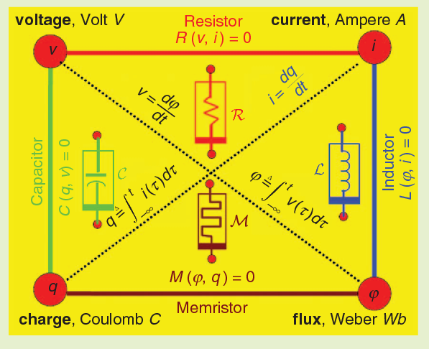

Slide 60
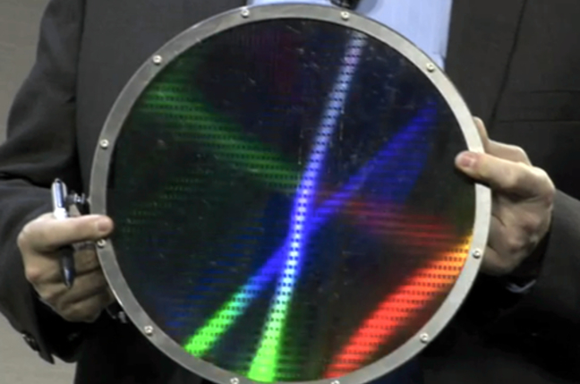
Memristors: Now? Never?
HP had predicted 100 TByte memristor drives by 2018.
The drives were to be packaged in “blade boxes,” providing a total of 24 Petabytes/box.
HP has not delivered on their forecasts. Although HP’s CTO talked confidently of HP 100TB Memristor drives, they have not materialized.
Since HP has sold its product R&D, memristor memory will be largely delayed or cancelled.
A memristor production slice. Production is still possible, but large memristor memories will not appear until around 2020 if at all.

Slide 61
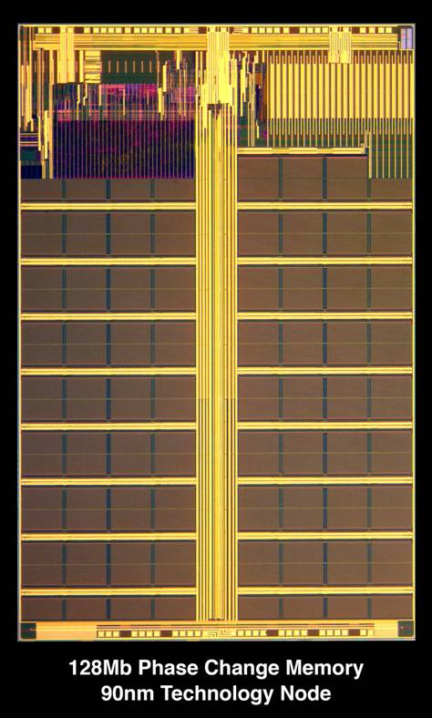
Memory (3)
Another new memory type is Phase Change Memory (“PCM”).
  Heated to a high temperature, the device produces an amorphous crystal (disorganized structure), with high conductivity. This is a 1.
  To write a 0, the material is heated to a lower temperature, creating an organized crystal structure with low conductivity.
  Still experimental. Can be read/written about 100 million times—far too low. DRAM and flash memory can do 1-10 quadrillion cycles!).
Still on the far horizon.

Slide 62
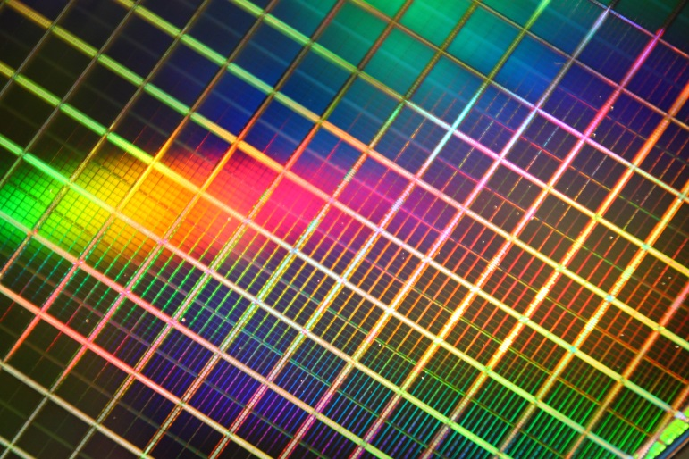
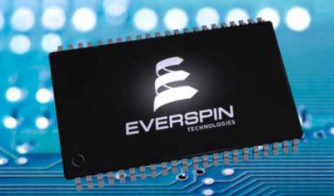
Other Memories—MRAM
Magnetic RAM (MRAM) – Uses tunneling resistance that depends on the relative magnetization of ferromagnetic electrodes. Production devices now sold by Everspin.
As of last week, Everspin appears to be surviving: “Everspin Technologies announced its financial results for Q3 2019, with revenues of $9.2 million (down from $11.5 million in Q3 2018) and a net loss of $3.7 million (down from $5.6 million in Q3 2018). Everspin says that it achieved record STT-MRAM revenues.

Slide 63
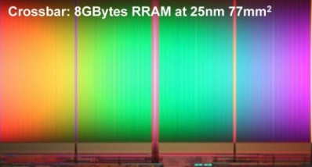

ReRAM
Resistive RAM (ReRAM) – A non-volatile memory in which a pulse voltage is applied to a metal oxide thin film, creating massive changes in resistance to record ones and zeros.
Using metal oxide placed between electrodes, the manufacturing process is very simple, while still offering low power consumption and fast write.
Progress on this technology appears to be accelerating as of the end of 2019. A Fujitsu product is shown.
Used in smart watches, smart glass, and hearing aids.

Slide 64
The CPU
Intel and AMD abandoned the GHz race in CPU’s years ago. In the early 2000’s, Intel stated a goal of a 10 GHz CPU by 2010—which clearly didn’t happen.
Multiple CPU’s became the performance enhancer. The standard is now 4- to 10- core CPU’s, with the new Intel Core i9 at even larger numbers of cores.
The new “Kabylake” architecture (still at 14 nm) has allowed Intel to achieve up to 18-core CPUs, with 8- and 10-core performance CPU’s as well. Speed is inching up—maybe to 5 GHz by 2020. Or maybe not.

Slide 65
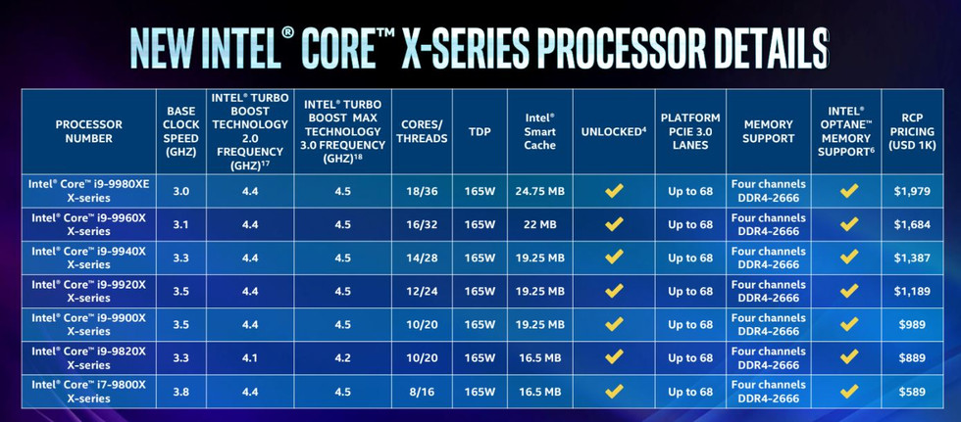

Slide 66
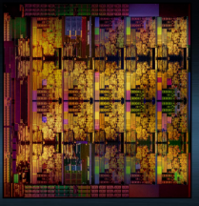
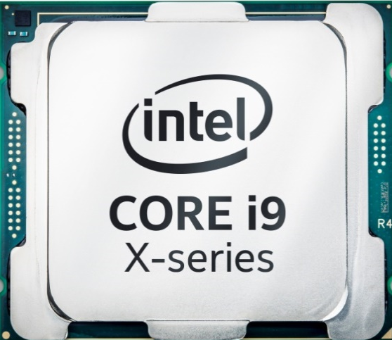
Intel Core i9
Core i9 9980XE
Intel® Smart Cache | 25 MB
Cores/Threads | 18/36
Instruction Set | 64-bit
Lithography | 14 nm¹ (Still!)
CPU Speed/Pwr. | 2.6-4.2 GHz² /165W.
Recommended Customer Price | $1-2000—Shipped in early 2018.
¹ “Skylake,” “Kabylake,” or “Coffeelake”
² Turbo boost

Slide 67
Minimum Feature Size
“Minimum feature size” (MFS): the smallest dimension that can be laid out on a chip (typically the gate).
Until recently, the minimum feature size for DRAM memory was about 20 nanometers (one nanometer is one billionth of a meter in length [10^{–9} meters]). Currently, Samsung has announced 10 nanometer DRAMs. AS DRAM MFS was not supposed to reach 10 nanometers until the late ’20’s, this appears to be a major breakthrough.
It appears that DRAM manufacturers (or at least Samsung?) approach CPU chipmakers in terms of manufacturing technology.

Slide 68
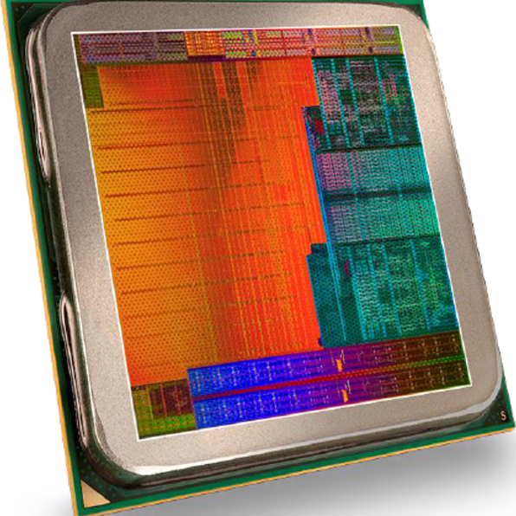
What About MFS in CPU’s?
Intel currently manufactures CPU’s at the 14 nanometer node and is sampling 10 nm products this year. They claim that they will produce the first 7 nm sample chips this year.
But note: Intel is 2 YEARS late with its 10 nm technology.
But note: AMD’s new super-processor is 7 nM technology! More in a moment.
AMD Laptop CPU Chip

Slide 69
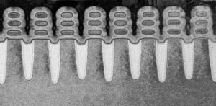
IBM’s New 5 nM Transistor
IBM’s breakthrough is first in 5 nm regime.
At 5 nM, production values of 30 billion transistors per CPU-sized chip are possible.
Power savings and CPU capabilities would be enormous.
Caution: 10-15 years from breakthrough to production is normal.

Slide 70
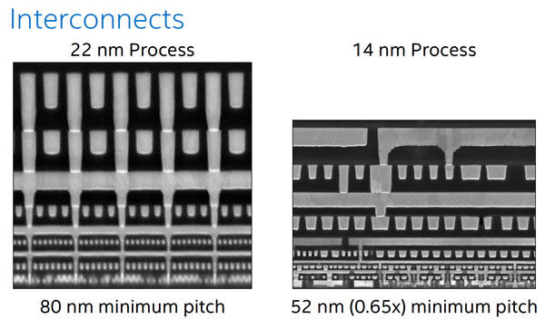
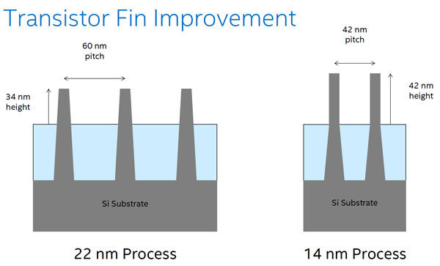
“Three-D” Technology
As feature sizes get smaller (22 nm→14 nm →10 nm), 3-D manufacturing processes continue to improve.
Generically referred to as “FINFET” due to the 3-d “fin.” Intel calls it “tri-gate.”
At right, comparison of transistor sizes in 22 and 14 nm processes (compare to 5 nm on previous page).

Slide 71
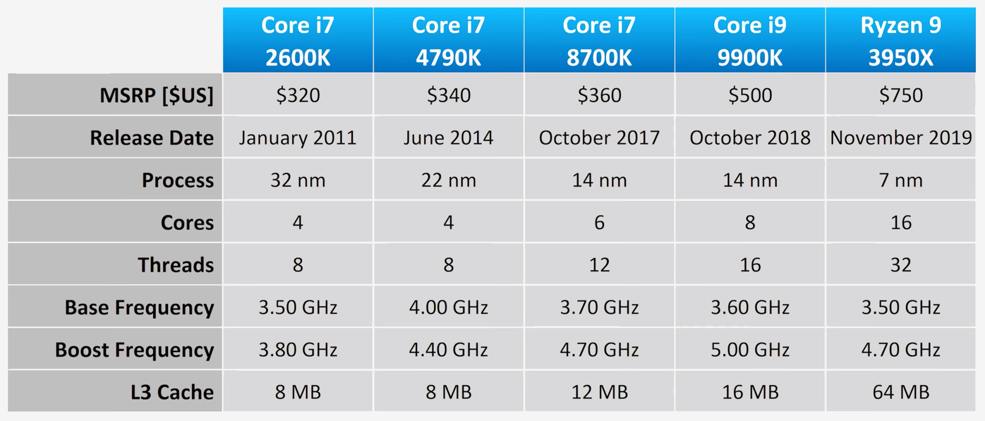
New Performance Champ—AMD Ryzen 3950X

Slide 72
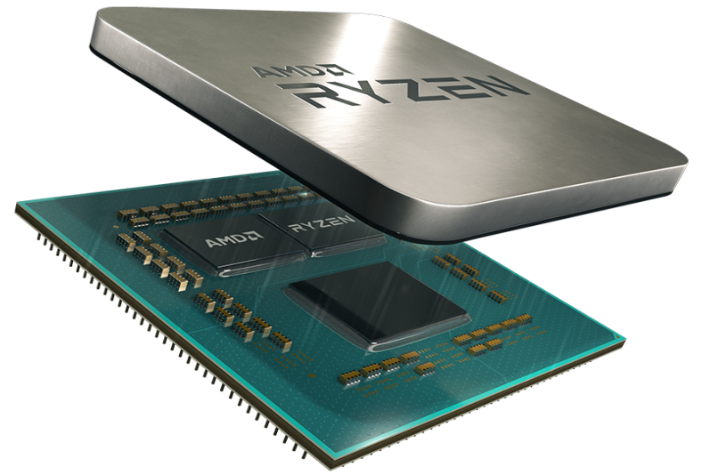
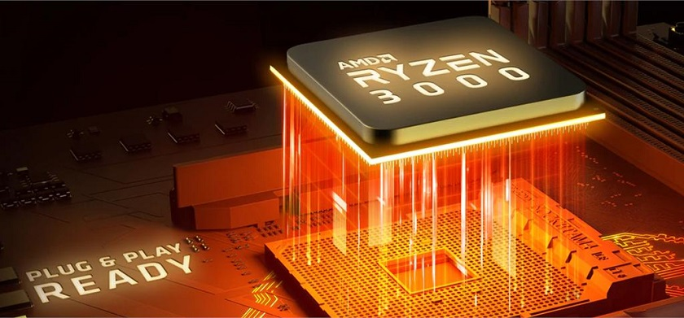
AMD 3950X
3950X Specifications
CPU Cores: 16
Threads: 32
Base Clock: 3.5GHz
Max Boost Clock: ~ 4.7GHz
L1 Cache: 1MB
L2 Cache: 8MB
L3 Cache: 64MB
CMOS, 7nm FinFET
Two memory channels, 3200 MHz.

Slide 73
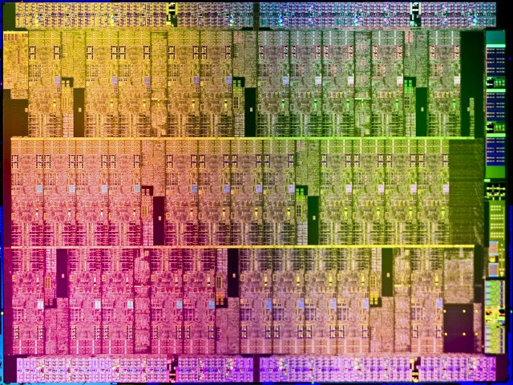
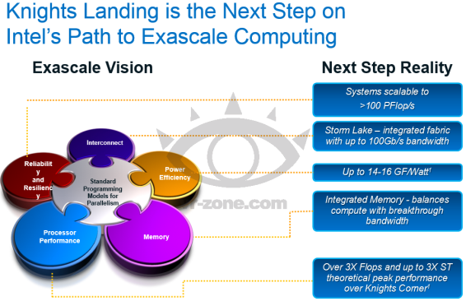
Multi-Core Advance
Intel has produced a 72-core CPU, “Knights Landing.” *
Available since late 2015, it has up to 16GB DRAM, up to 500GB/sec of memory bandwidth, plus up to 384GB of DDR4-2400 mainboard memory. KL will use the 14nm process. With a promise of 3 teraflops (double precision) per socket it will almost certainly be used to build some monster x86 supercomputers.
Intel Knights Landing,
with 72 Pentium cores with 64-bit support.
Xeon Phi is another version. Knight’s Landing
is a newer version of Knight’s Corner.

Slide 74
“Stampede” and Its Offspring
Developed on an NSF grant, the “Stampede” supercomputer debuted at the Texas Advanced Computing Center the University of Texas in 2012.
It used several thousand Dell “Zeus” servers, each with dual 8-core Intel Xeon processors and many of the Intel Knights Corner chips, a precursor to Knights Landing, with a total of 522,080 cores.
It had 270 Tbytes (yes, that TERA bytes) of DRAM and 14 Petabytes of storage memory.
Peak performance was 9,600,000,000,000,000 floating point operations per second (9.6 petaflops).

Slide 75
Offspring, Continued
In 2017, “Stampede 2” was introduced.
Faster and more powerful, this “Son of Stampede” was rated at 18 petaflops. To gain this speed, it uses thousands of Knight’s Landing Intel processors, along with a newer and even faster Xeon processor blade.
Stampede 2 has double the memory and bandwidth capacity, and a new inter-processor communication ability will deliver 100 Gigabits/second capacity.
But more and better is coming…

Slide 76
Grandchild of Stampede, “Frontera”
A 3rd-generation supercomputer is being built at present, the result of another NSF grant (of ~$60 M).
Currently benchmarked at about 35-36 petaflops, with roughly double the memory and bandwidth capacity of Stampede 2, Frontera will be aimed at technology development as well as servicing nationwide computing needs.
The ultimate goal will be a “Frontera 2” in 4-5 years, with a projected computational ability of up to 300-350 petaflops.

Slide 77
Intel: Sandy Bridge → Skylake
What about the “bread and butter” Intel PC CPU’s?
In the last few years, the Intel CPU family has gone through a large number of minimum feature size manufacturing processes*:
  “Sandy Bridge” (32 nm) →“Ivy Bridge” (22 nm, “FinFET”) → “Haswell” (Optimized FinFET, 22 nm) → “Broadwell” (14 nm) → “Skylake” (14 nm, new architecture, optimized FinFET → Kabylake (also 14 nm).
  Each generation has used less power, especially in the mobile-computing variants.
The latest chips have better graphics as well.
* Intel has odd MSF names, similar to Apple’s OS X updates – “Leopard,” “Snow Leopard,” “Lion.”

Slide 78
“Tick-Tock” Now Dead
Intel has followed a “Tick-Tock” manufacturing strategy.
  The “Tick” phase shrinks the MFS, while “Tock” introduces a new microarchitecture. Intel violated this “rule” with Kabylake.
Tick | Westmere (January, 2010, 32 nm)
Tock | Sandy Bridge (January, 2011, 32 nm)
Tick | Ivy Bridge (April, 2012, 22 nm)
Tock | Haswell (June, 2013, 22 nm)
Tick | Broadwell (October, 2014, 14 nm)
Tock | Sky Lake (Mid-2015, 14 nm)
Tock | Kaby Lake (2017—14 nm)
Tick? | Cannon Lake/Coffee Lake/Whisky Lake? (2018?—10 nm)
Tock? | Ice Lake (2018/19—MSF stated as “10 nm+)

Slide 79
Meet “Process-Architecture-Optimization” (PAO)

Slide 80
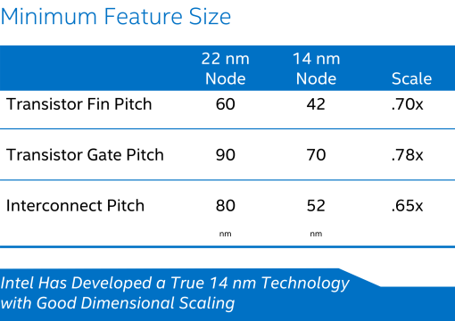
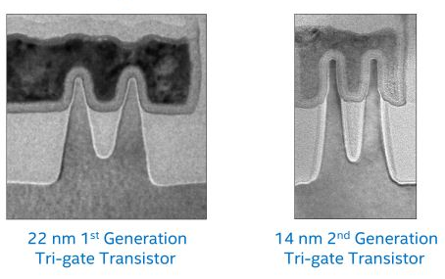
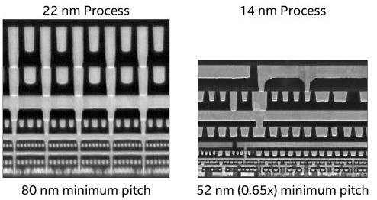
14 nM Production Problems
Intel has had problems with 14 nm scaling. They appear to be having the same problems with 10 nm.

Slide 81
What Comes Next in Intel’s “PAO” Development
Intel has missed the boat in recent MFS development.
It scheduled 10 nM to happen last year (2018).
But Samsung has been producing 10 nM memories for some time!
What then? Based on delays so far, Intel now projects launching 7 NM in late 2020 (see chart).
They still claim that 5 nM will happen by 2022/2023.
That appears very optimistic based on PAO.
Moore’s law, while not officially dead, is quite ill. And probably on its last legs.
More on Moore’s in a moment!

Slide 82
Will We Need Graphics Processors?
For high-performance graphics (e.g., video games), PC gamers add one or more high-performance video cards.
With many-core chips, that may not be necessary. Many of the cores may be used for graphics generation.
Better still, put GPU’s on the chip! Interestingly enough, Intel and nVidia signed a cross-licensing agreement in 2012, giving Intel access to nVidia’s GPU designs.
For Skylake and forward, it appears that graphics processors are included as CPU cores in some cases. Graphics cards may become unnecessary!

Slide 83
The End of Moore’s Law?
“Moore’s Law” appeared in an article by Gordon Moore (then CEO of Intel) written in 1965.
Not really a “law,” it was merely an observation that the number of devices (transistors) on a silicon chip doubled every 18-24 months.
Today, the 24-month cycle is considered more accurate.
Moore’s Law has continued unabated for 50 years, with an overall advance of a factor of roughly 2³¹, or 2 billion.
That means memory chips today story around 2 billion times as much data as in 1965.
Or, in more general terms, computer hardware today is around 2 billion times as powerful for the same cost.

Slide 84
The End of Moore’s Law? (2)
It is hard to comprehend the relative progress expressed by Moore’s law.
Imagine airplane technology advancing at nearly that rate from 1965 to 2015:
  Today’s airliners would travel nearly at the speed of light (1,080 million kph or 670 million mph).
  They would be large enough to contain the entire world’s population.
  Or an airliner with the capacity of those in 1965 (think Boeing 707) would cost, not US $100 million, but $1!
  Yet even these analogies fall far short of a factor of 2 billion.

Slide 85
The End of Moore’s Law? (3)
Achieving very small MFS is getting much harder.
Using current methods below 10 nm will grow increasingly difficult (although AMD is “doing” 7 nm and IBM’s has produced proof of feasibility of 5 nm.
The “Moore’s Law era,” where circuits/chip doubled every 24 months, and costs reduced by ½ is ending.
Will circuits continue to shrink in size?
Undoubtedly. But current manufacturing techniques will have to give way to other methods.
The only theoretical limit to the size of a switching element is the size of an electron in an atomic well!

Slide 86
The Successor to Windows 10?
Microsoft is very cagy about the successor to W10.
  It has announced that W10 is “the last windows,” but absolutely nothing yet about its successor.
No word on a Windows successor. However, the latest Microsoft Windows 10 updates are “Redstone 4” and Redstone 5.”
“Redstone 4” was released in April, 2018.
Redstone 5 was released for download a few months ago. What’s next?

Slide 87
Polaris
Microsoft had an internal project that was reportedly a new pared-down version of Windows code-named Polaris. Not a successor to Windows 10 in the traditional sense, it’s an alternative OS more like iOS or Chrome OS—designed for ultra-mobile laptops, 2-in-1’s, and tablets.
However, Microsoft recently killed Polaris.
Another potential new version of Windows 10™ was to be based on a new, simple core version of the OS called “Windows Core OS.”

Slide 88
What is “Windows Core OS?”
Windows Core OS was a very simple core OS that would have only basic OS features (that is, rather Linux-like).
A core version of Windows OS would imply that any new form-factor of device could have its very own Windows operating system with only the features it needs.
Such a design would potentially increase battery life and performance, and make the whole “user experience” easier and simpler.
Such a core system would be similar to the operating systems that have come to dominate the mobile space in recent years.
However, Microsoft also recently killed “Core OS as well!
Another potential Windows 10 successor, “Santorini,” is still in the works. Will it survive? At this point, chances are 50-50. Santorini is officially described as a “Windows Lite”—maybe for portables?

Slide 89

The Next Windows?
Our very own James Larus, who developed PCSPIM and QtSPIM, worked at Microsoft for several years before becoming Dean of Ecole Polytechnique Federale De Lausanne.
He was the lead in developing Singularity, an OS and tool builder that has been extremely popular at Microsoft for many software projects, and which was released to researchers for free.
There has been speculation that a commercial version of Singularity might become the next “Windows”—or at least the next Microsoft OS.
That probably will not happen. However, it is possible that an OS based on Singularity (maybe Windows 12?) could become the next Microsoft OS.

Slide 90

Other Computer-Based State-of-the-Art Electronics
The standard in TV’s is now 4K—four times HD resolution.
The other advance is OLED, a much sharper display than even LED-backlit LCD displays. 65-inch TV’s are out, 75 is coming.
Million-dollar+ commercial TV’s are available in extremely large sizes (think Cowboy Stadium).
Samsung has built a 110-inch, 4K curved-screen, 3D LED home set (currently not for sale).
A Samsung 82-inch TV can now be had for < $4000!
The newest thing in LED TV’s is HDR*—gets close to OLED.
Samsung 110” 4K TV
* High dynamic range.

Slide 91
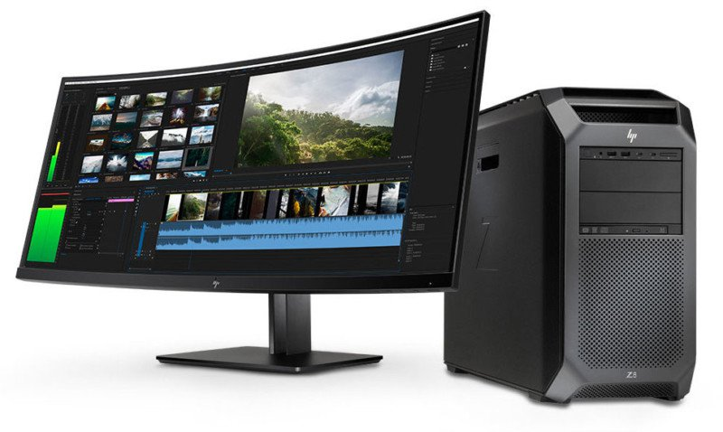
New Hewlett Packard Desktop—Wow!

Slide 92
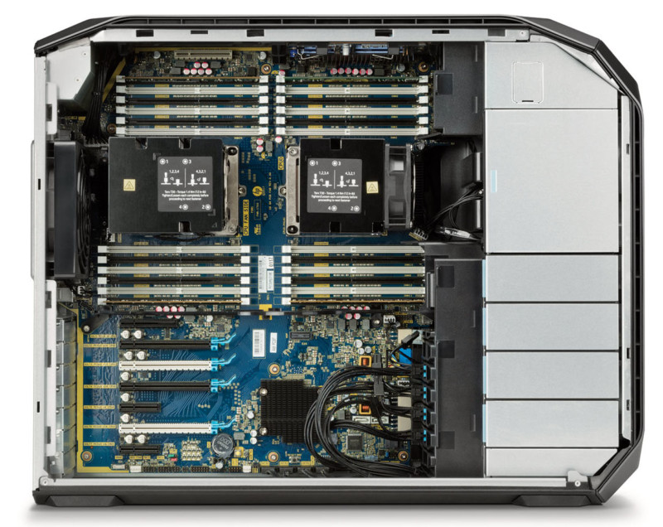
Interior Shot
For storage, the Z8’s 48 terabytes of space could solve your problem if you’d like to keep your entire lifetime archive of photos close at hand on your workstation!
The Z8 can be furnished with three (3) TERABYTES of DRAM and forty-eight (48) TB of flash storage! Clearly meant for heavy engineering design and top-line animation efforts!

Slide 93
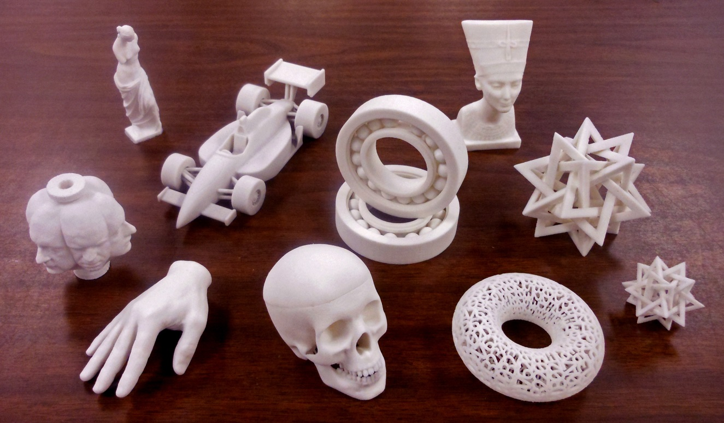
3-D Printing
The development of 3D printers over the last few years has been astonishing.

Slide 94
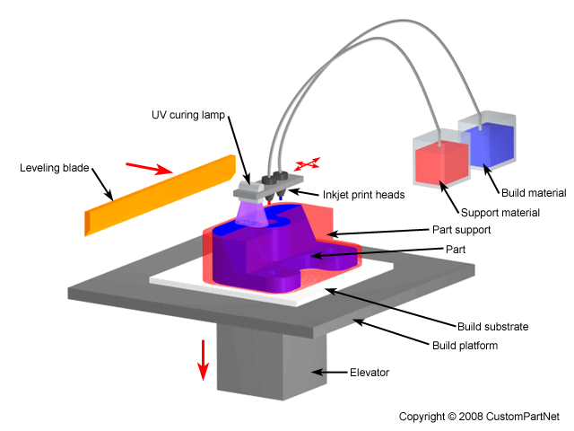
3D Printing Example
Courtesy: 3D Printing.com
There are many 3D printing methods.
In the example above, a printing mechanism, much like an inkjet printer, deposits material on a base to build up a 3D part.

Slide 95
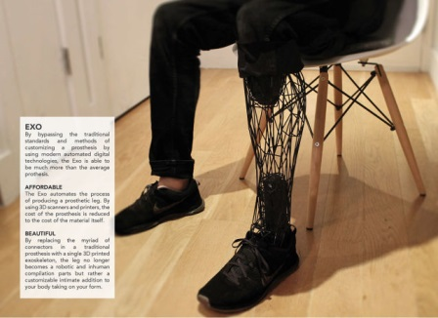
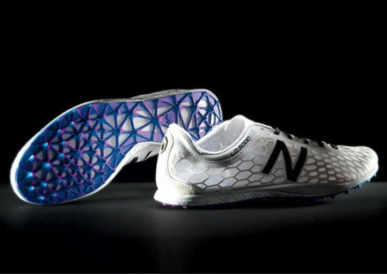

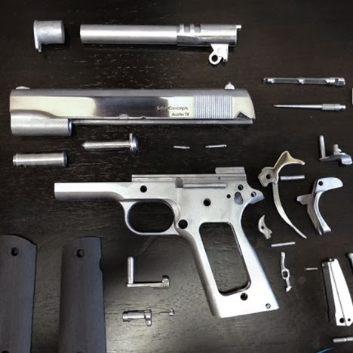
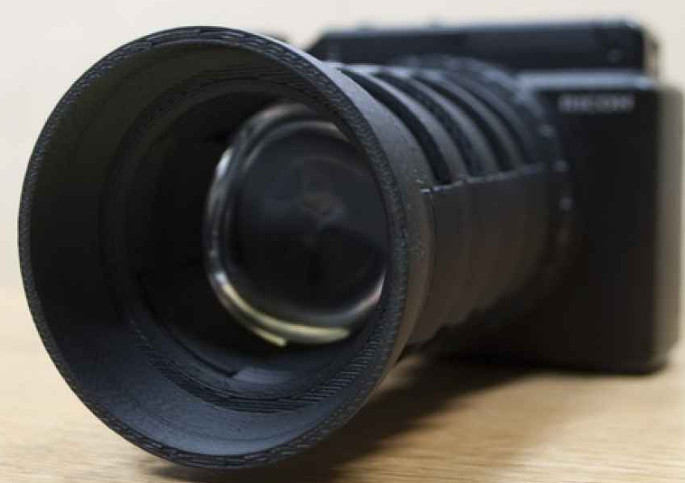

Just About ANYTHING Can Be Printed!

Slide 96
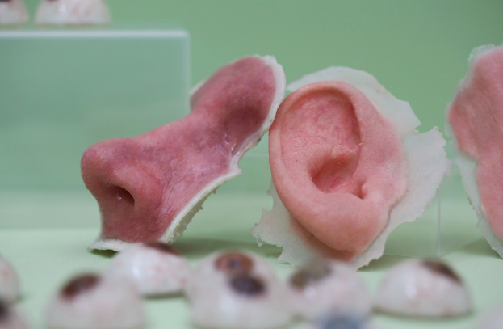
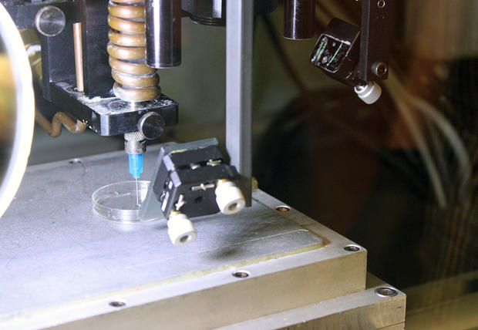
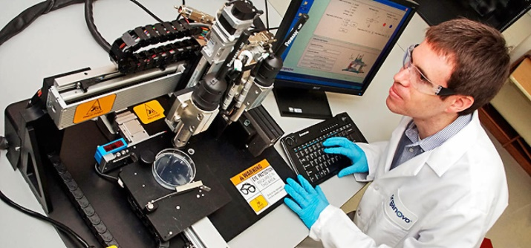
3-D Printing of Human Organs
3D printers are being used more and more in bioengineering.
Above left: Printed prosthetics for the face and head.
Below left: A 3D printer prints blood vessels and connective tissue matrices.
Above right: Printed “biomatrices” for organ growth.

Slide 97
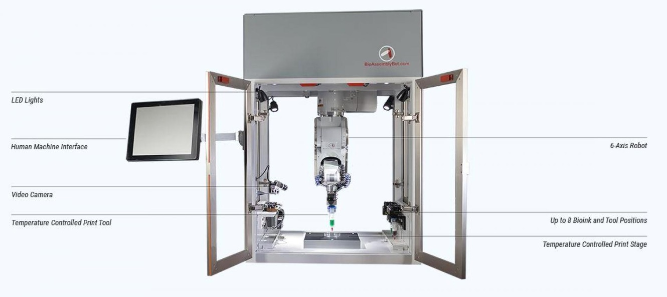
Bioprinters Make News
One new development is a bioprinter that directly prints human organs in a matrix.
Above is such an example, although a number of companies are in the process of design (and even producing) these printers.

Slide 98


2021 Byton M-Byte: Car or Mobile Computer?
New vehicle manufacturer Byton promises to “out-Tesla Tesla.”
The focus of this 2021/2022 SUV is on connectivity and web accessibility. All-electric like a Tesla, it boasts far more electronics.

Slide 99
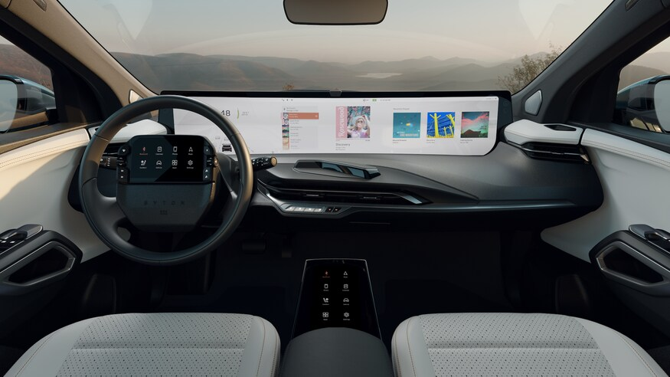
2021 Byton M-Byte (Continued)
Byton’s focus is the interior—get that 48-inch driver/passenger display!
Will include access to entertainment services, movies, dining choices, and even an “office mode” to work while in the car. The driver will be able to do that because of “fully autonomous” automatic driving.
Prices to range in the area of $45K-70K.

